Slide 1
12 month boy
Presented acutely with suspected right hip pain 4 days ago and refusing
to walk on leg. Recent upper respiratory viral infection, now resolved.
Initial radiograph and ultrasound were suggestive of transient synovitis of
the right hip.
Patient treated conservatively with anti-inflammatories and hip “pain”
improved over the next couple of days. At follow up examination the
paediatrician noticed poor/absent reflexes in the right leg and the child
was still reluctant to bear weight on the right leg.
MRI shows no sign of hip effusion (or other hip abnormality) but does
show thickened high signal intensity lumbosacral plexus bilaterally with
asymmetry of the right femoral and sciatic nerves.
Is this post inflammatory/infectious? Suggested lumbar puncture
Any other suggested investigations? White cells/CRP are normal.

Slide 2
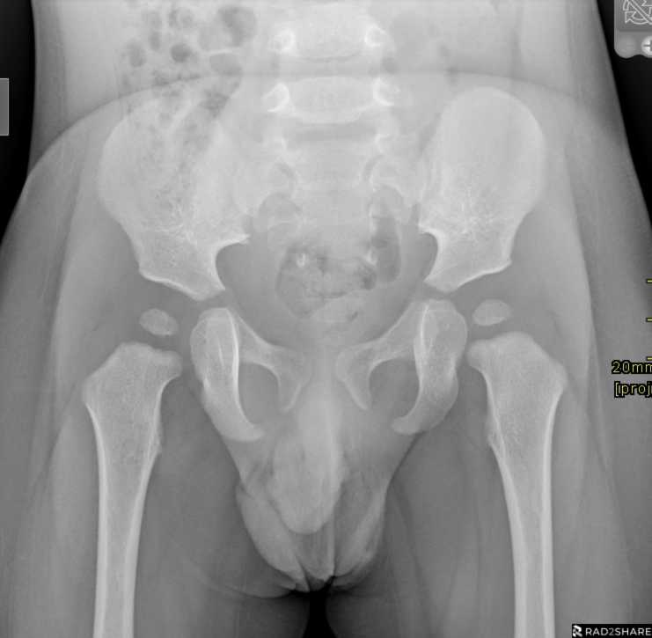

Slide 3
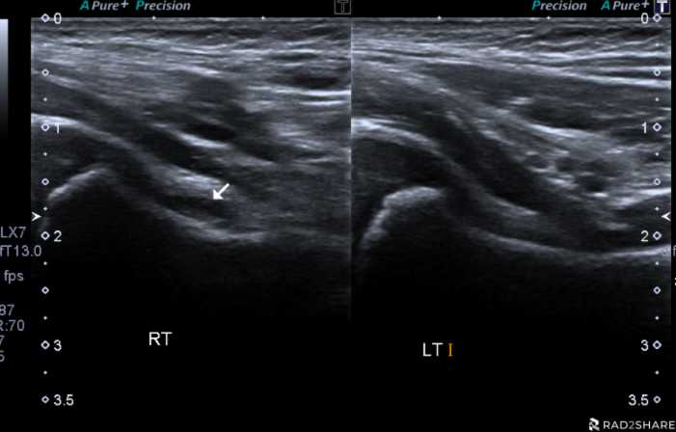

Slide 4
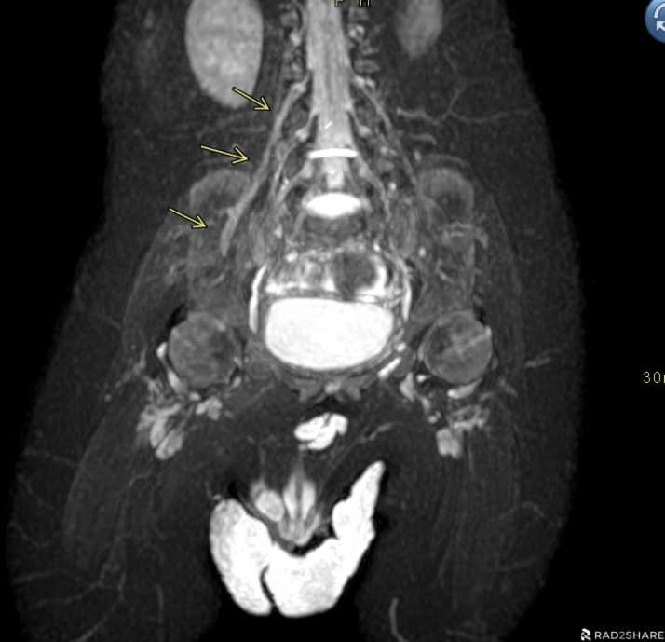

Slide 5
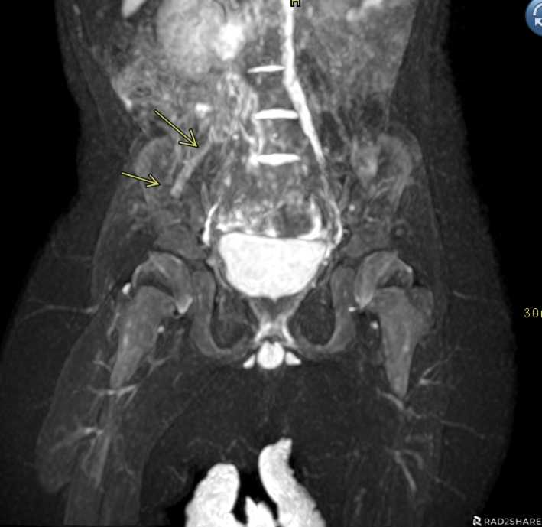

Slide 6
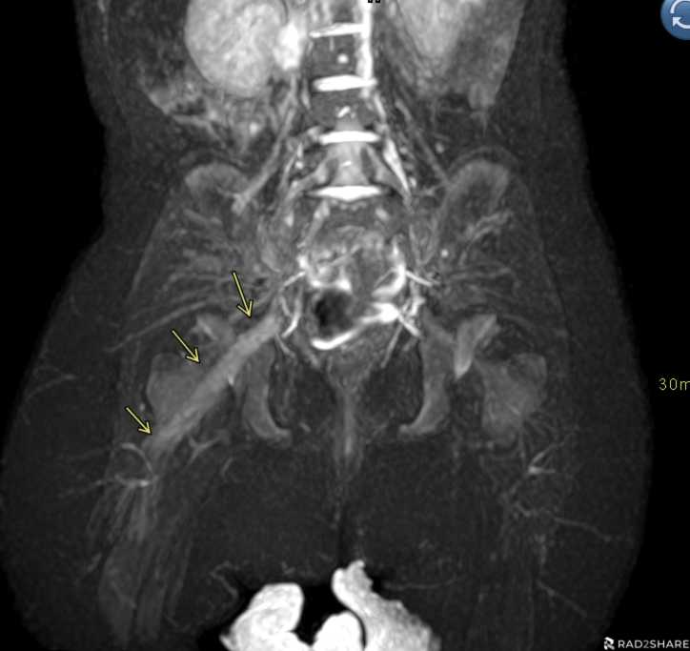

Slide 7
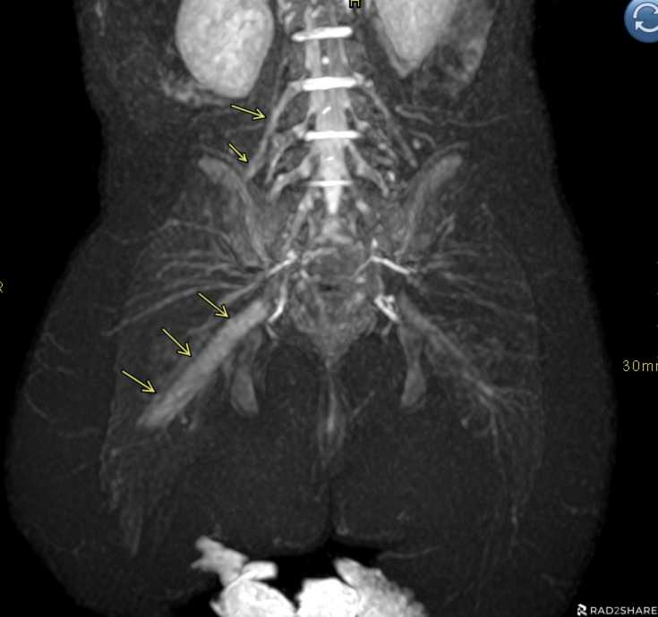

Slide 8
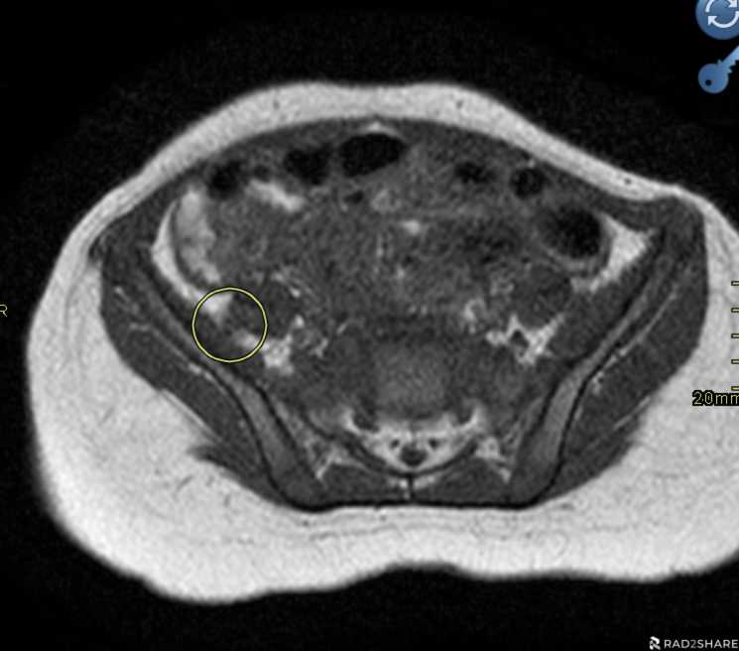

Slide 9
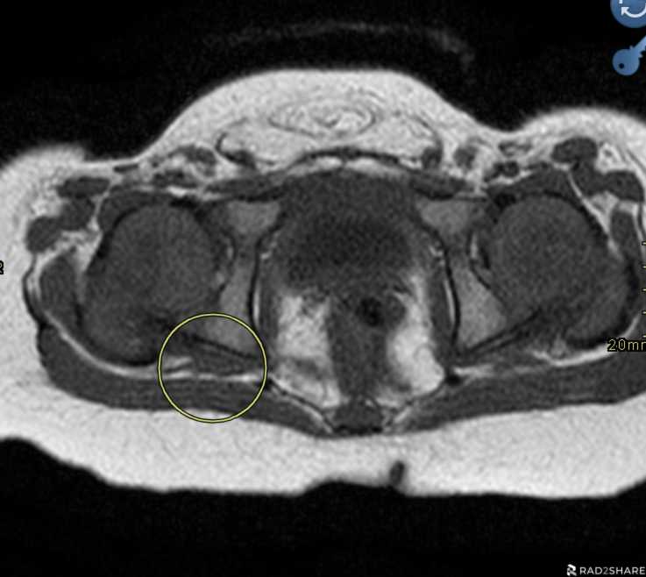

Slide 10
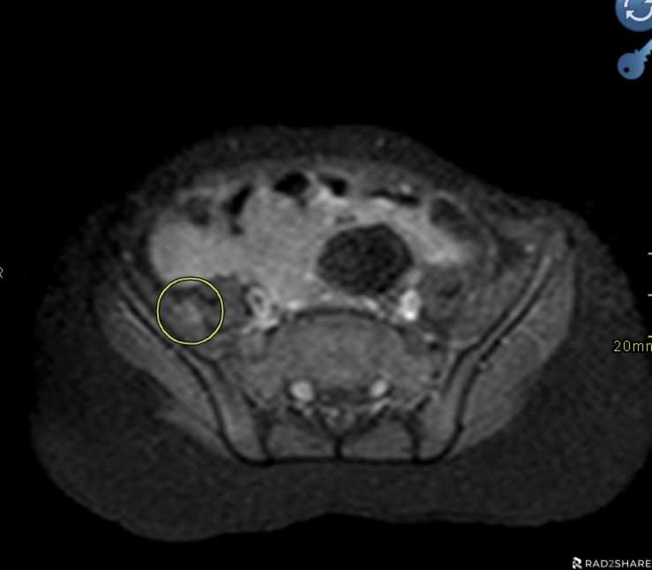

Slide 11
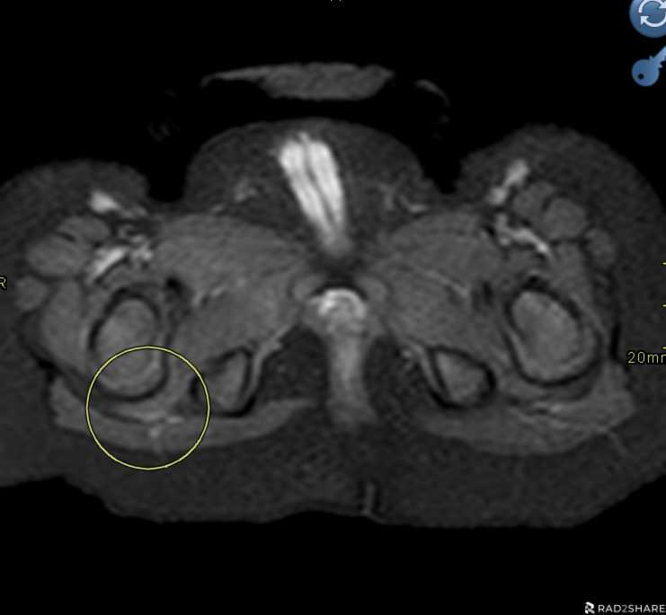

Slide 12
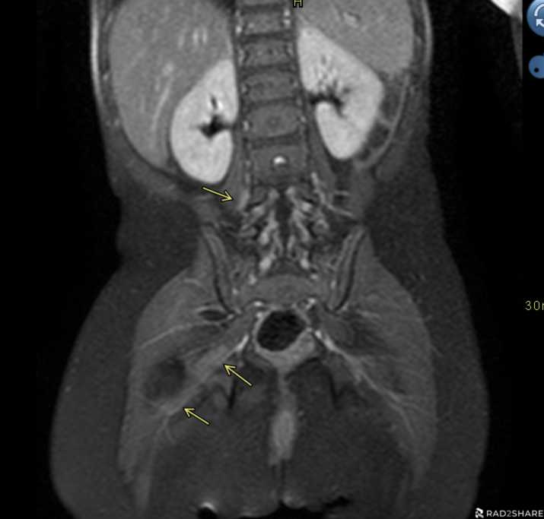

Slide 13
