Slide 1
OCAD CASE
Male, 26 Years old, profissional soccer player
Bilateral heel pain
Bilateral calcaneal tendinopathy?
Cláudio Régis Silveira, MD
Carlos Henrique Alencar, MD
São Carlos Hospital, Fortaleza, CE, Brazil

Slide 2
MRI - Bilateral calcaneal tendinopathy confirmed
DP Sag Right Ankle
DP Sag Left Ankle

Slide 3
MRI - Left Ankle - Additional finding
T1 Ax
DP Ax

Slide 4
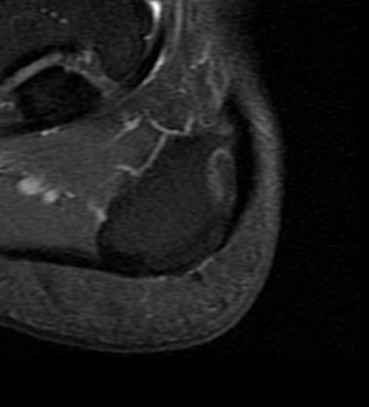
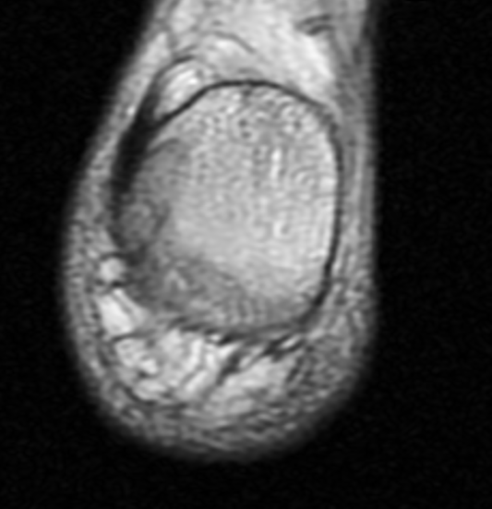
MRI - Left Ankle - Additional finding
T1 Sag
DP Sag
DP Cor
T1 Cor

Slide 5
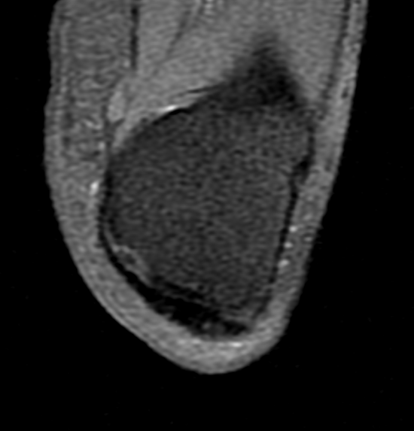
MRI - Left Ankle - Additional finding
T1 C+ Sag
T1 C+ Ax
T1 C+ Ax

Slide 6
Hypothesis for the additional finding?
Atypical subcortical stress fracture?
Pre-avulsion fracture lesion?
Atypical osteochondrosis/osteonecrosis?
More suggestions?

