Slide 1
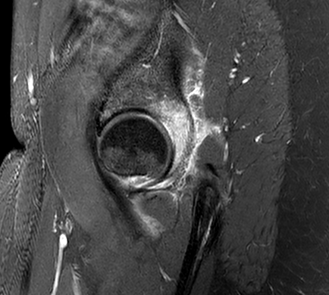
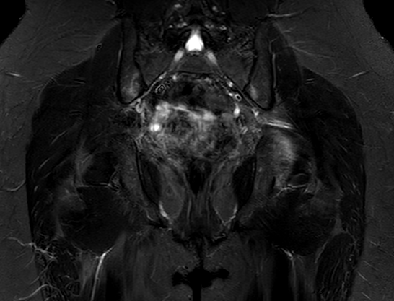
39 YO Female presents to ER with “sudden” and significant Left hip pain. Past Med Hx otherwise unremarkable
T1W-fs with con
STIR

Slide 2
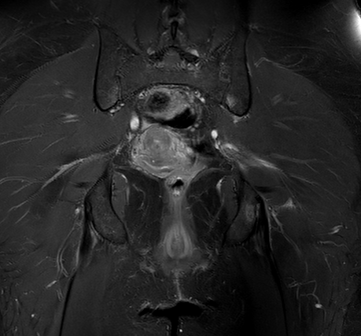
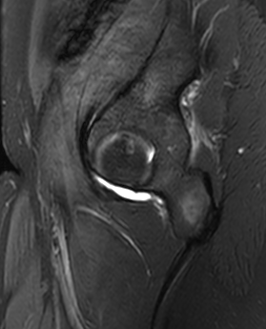
T1W-fs with
PD fs

Slide 3
