Slide 1
15M with 3 weeks of medial knee pain and locking
No known trauma

Slide 2
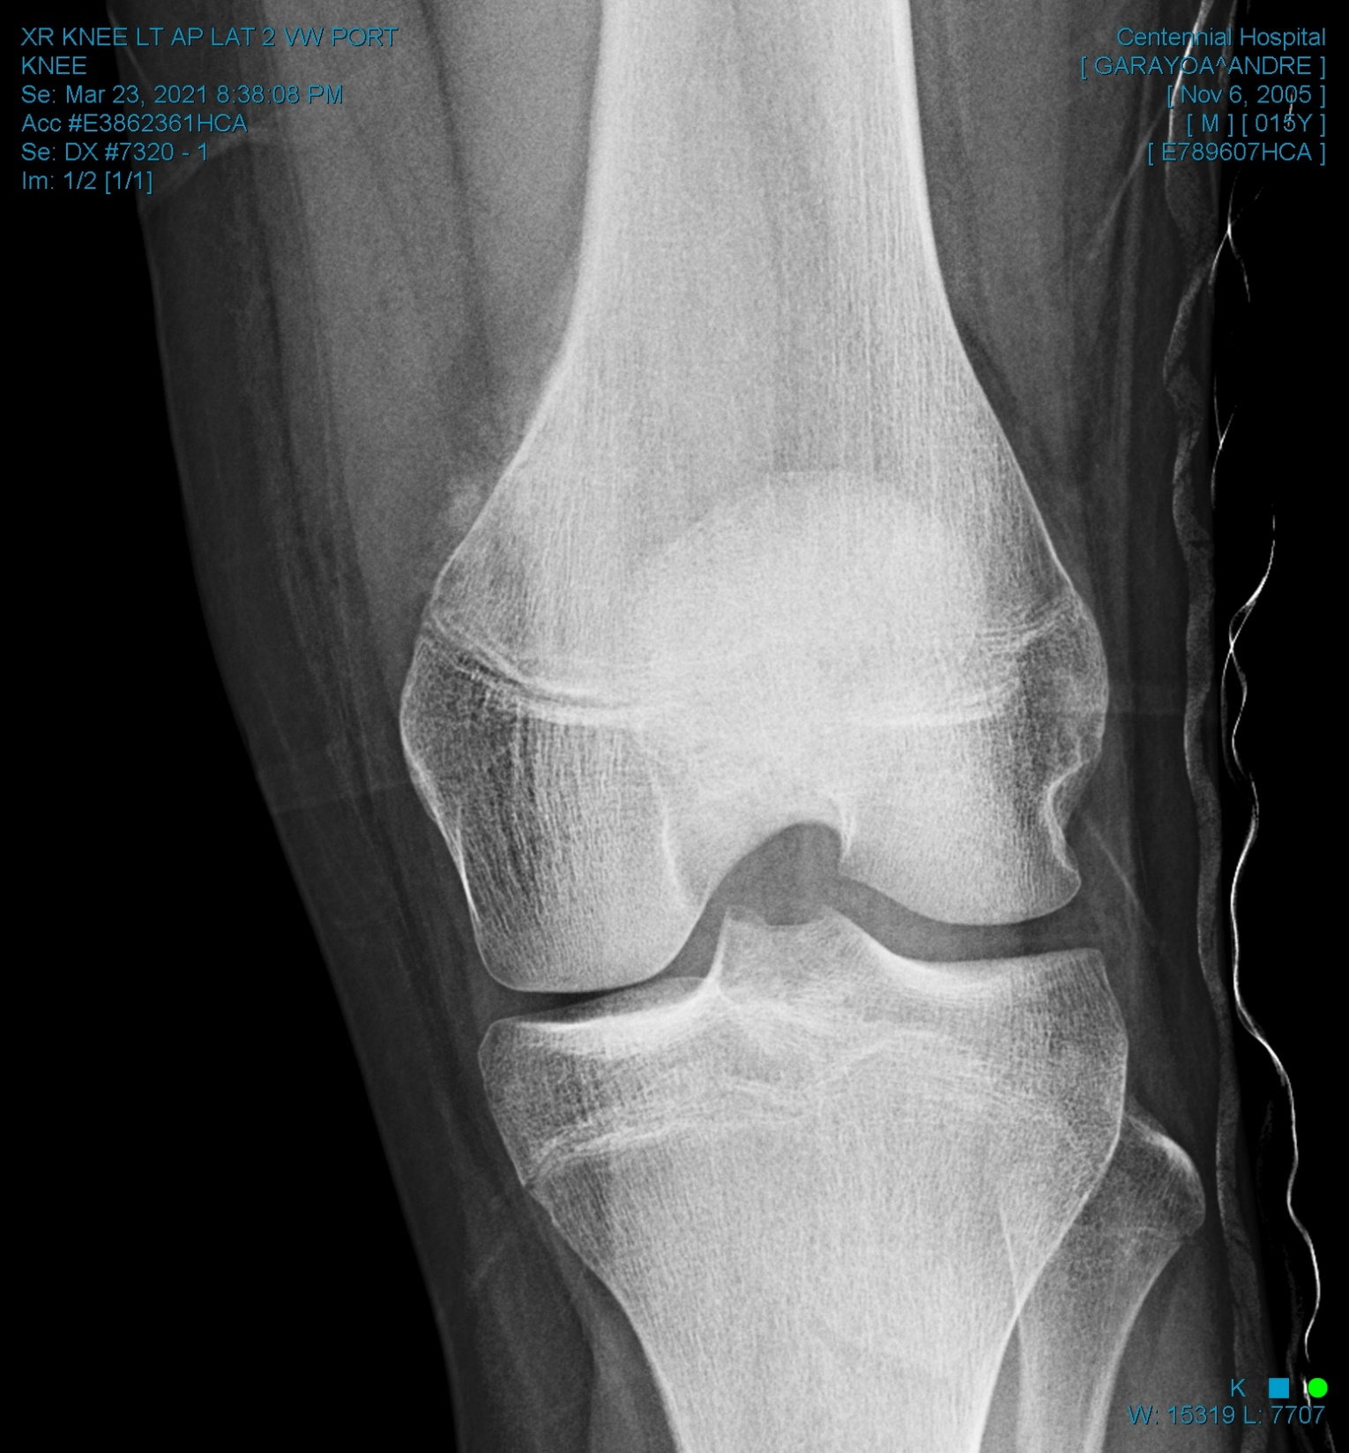
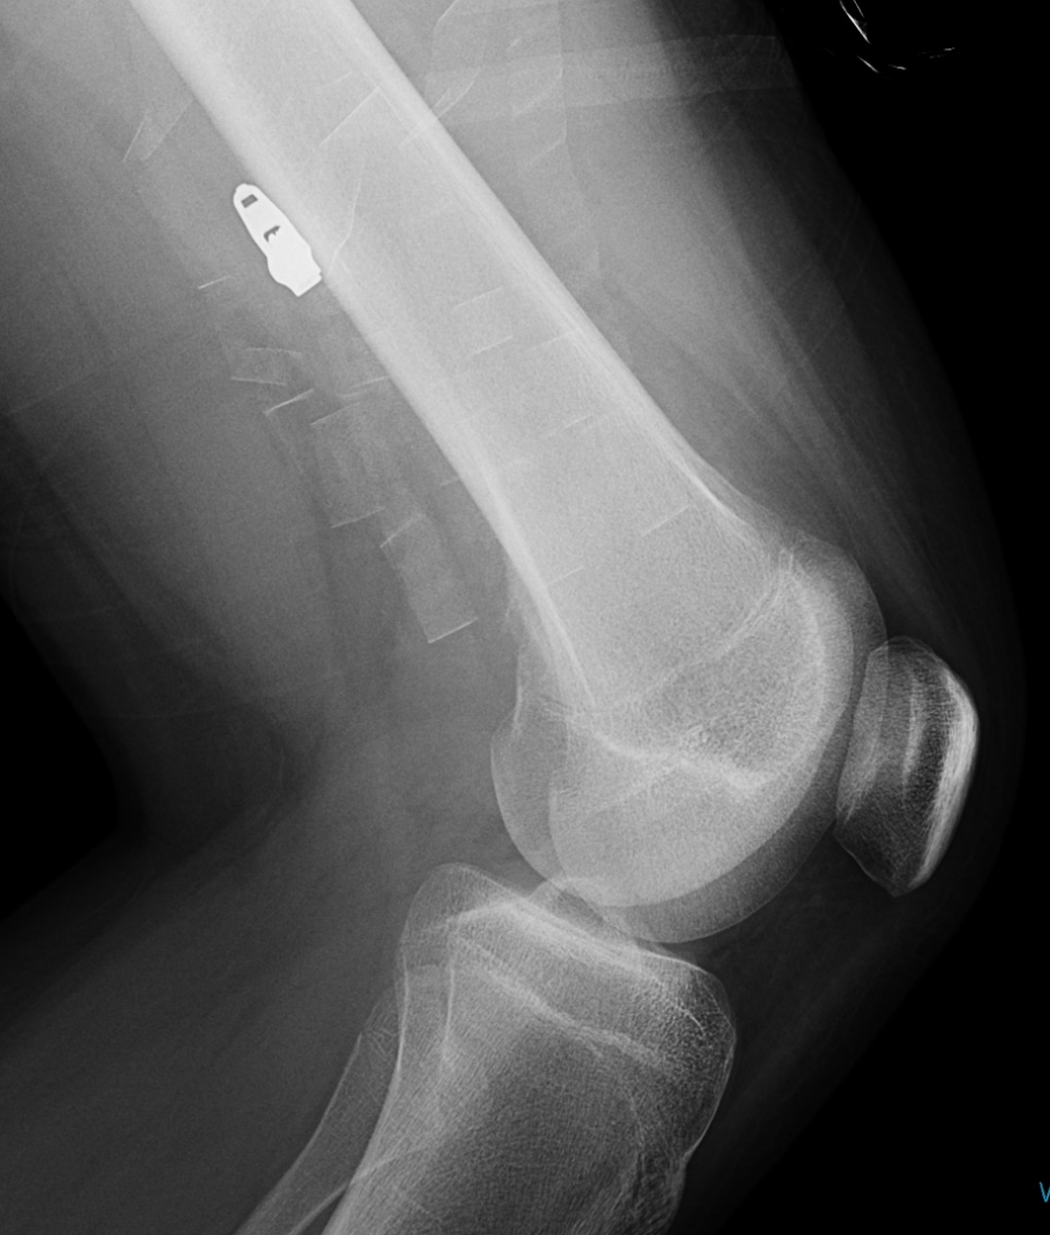

Slide 5
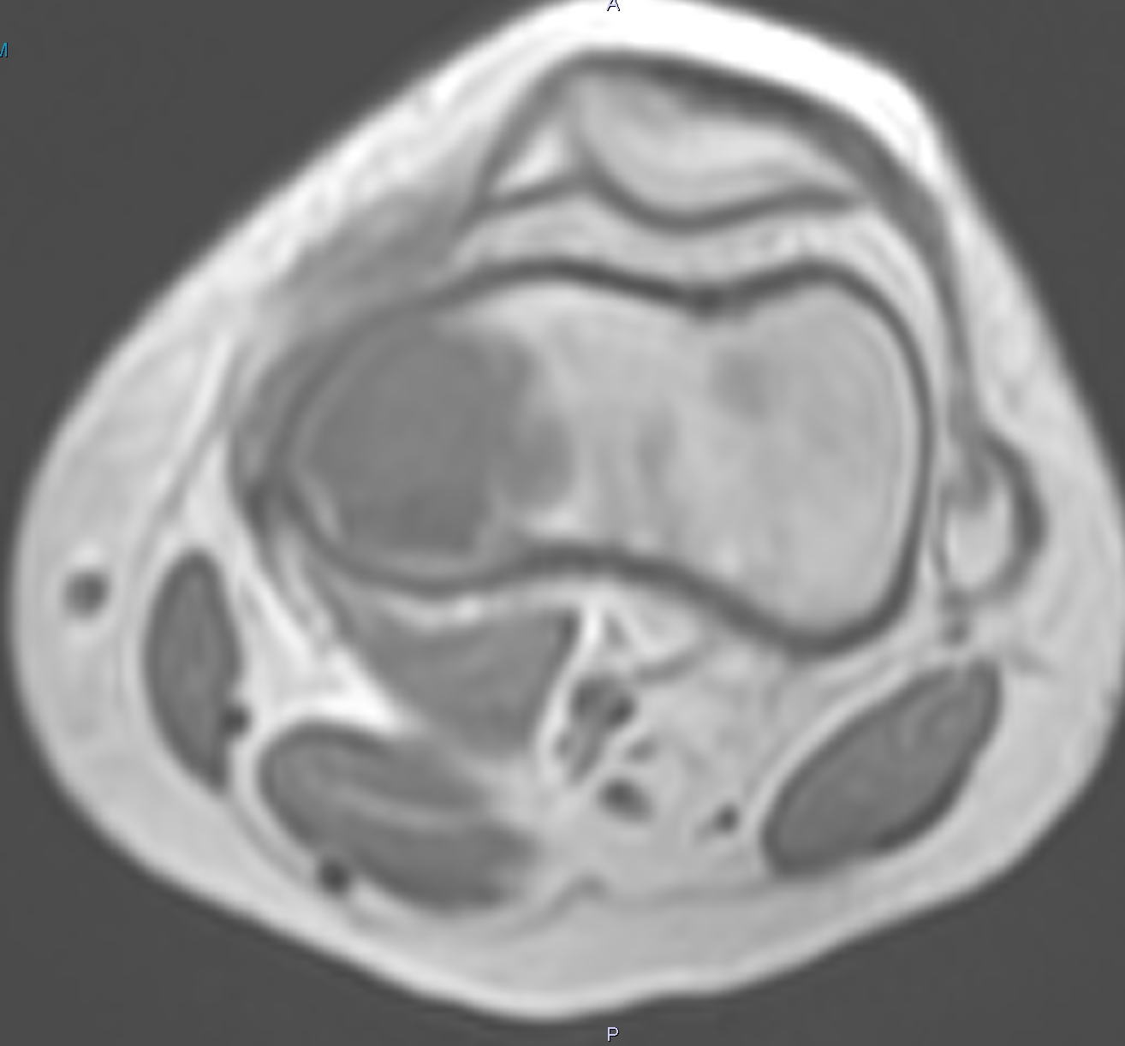

Slide 7
Biopsy performed the next morning: High-grade chondroblastic osteosarcoma

