Slide 1
female
44 yo
investigate subacromial impingement

Slide 2
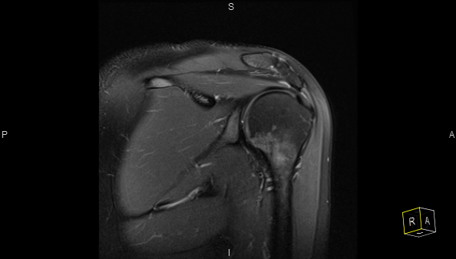
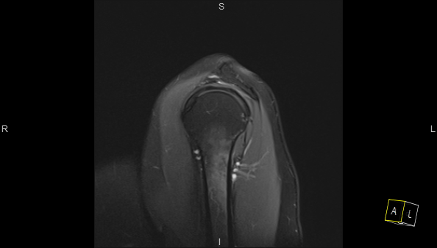
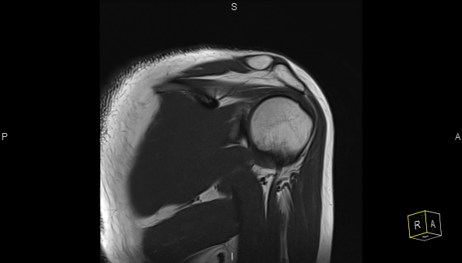
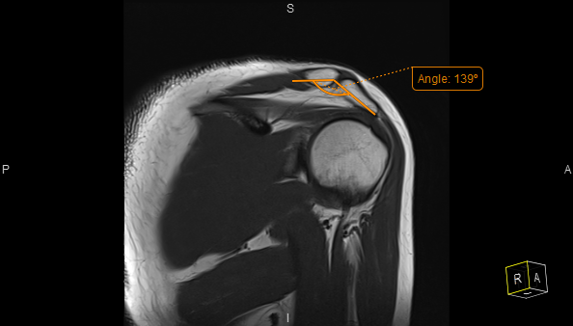

Slide 3
seem a steep acromial lateral downslope
have in mind that despite the intuitive will to label impingement there is no literature support
any of the colleagues have sources or opinions forward or against such a lateral acromion downslope issue?
🤔

