Slide 1
16 yo female
allergy historic
long standing joint intermittent pain episodes, including knees
now:
mild 3rd 4th and moderate 2nd finger dactylitis
ps:. what brights in fluid sensitive is really edema, not artefact

Slide 2
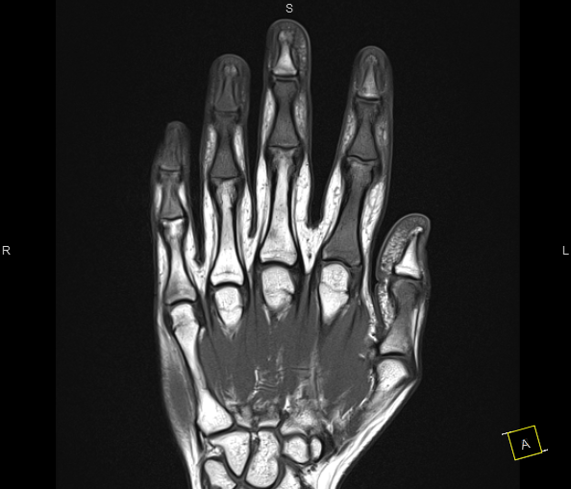
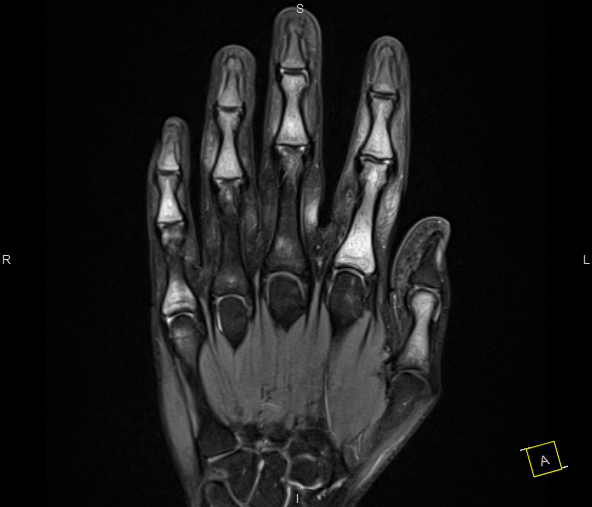

Slide 3
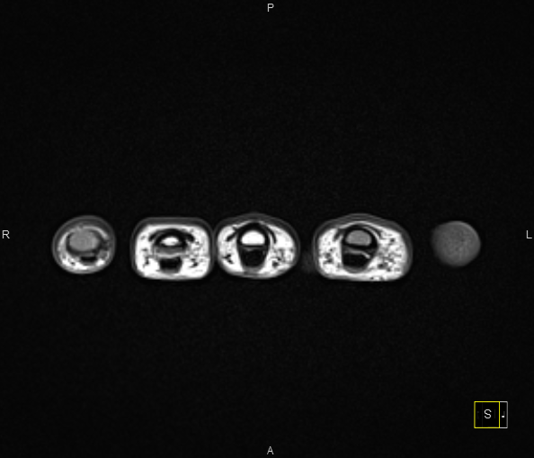
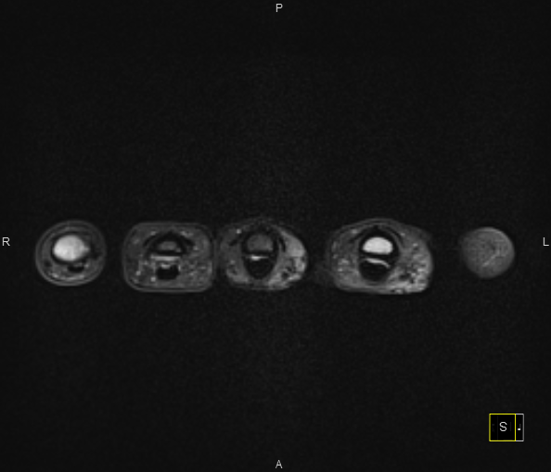

Slide 4
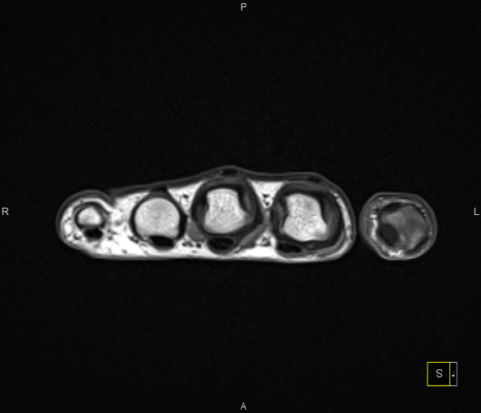
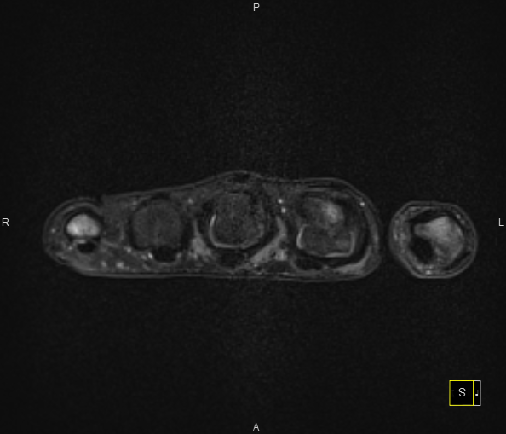

Slide 5
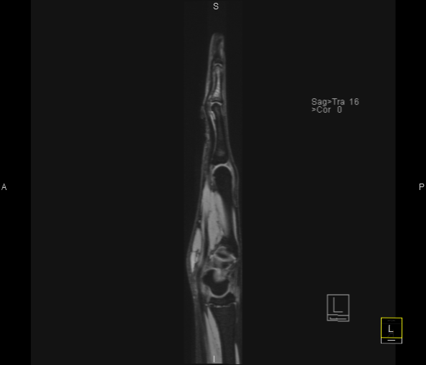

Slide 6
hypothesis:
chronic recurrent non-bacterial osteomyelitis/ osteitis
juvenile rheumatoid arthritis
early onset spondyloarthropathy?
thoughts?

