Slide 1
Please Help…
-58 years old female patient, she is a general doctor and physical therapyst.
-Hypercoagulation syndrome, antiphospholipid syndrome, Pulmonary embolism 2001 and 2002, actual treatment with anticoagulation therapy and Inferior Cava Vein Filter.
- Qx: appendix, gallbladder, and 4 hip replacement, 2 in each joint due to metallosis. One with compartimental syndrome post surgery due to bleending of the hip ( 2012).
Cavernous sinus thombosis 2015.
November 2020, started with pain in the inner anterior portion of the knee, with a palpable node on december, very painful, with a vascularized superfitial Doppler node at ultrasound at the anteromedial knee.
Surgical resection Decembre 27, 2020 with histology of Proliferative Fasciitis.
12 days after surgery started with severe pain and inflamation, MRI suspected hematoma, due to fast growth and high Doppler at US in February 3th went again to surgery with reported of proliferative fasciitis.
February 14 severe pain and again a node with increased size in every day. Images from today US and MRI proveded next.

Slide 2
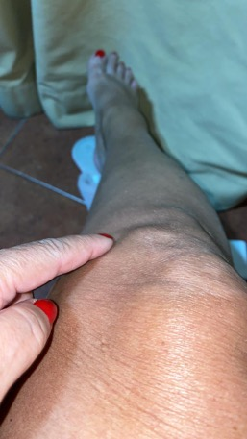
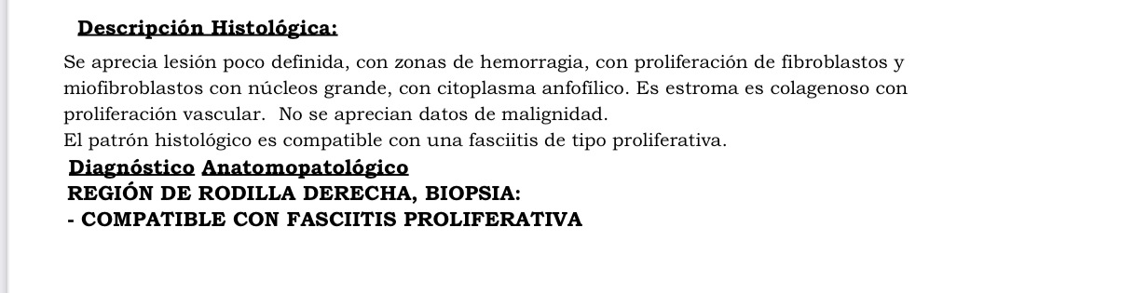
Before first surgery and histology

Slide 3
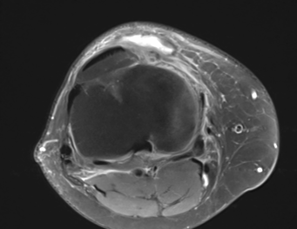
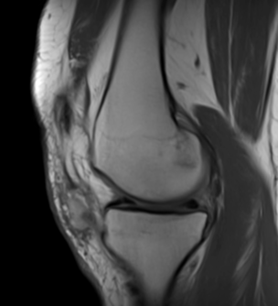
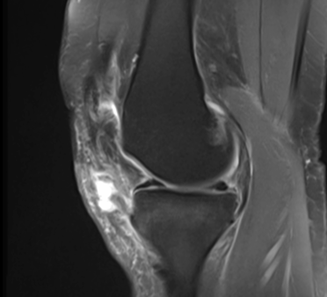
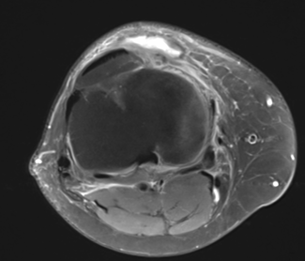
MRI after first surgery, 22/01/2021 ( non contrast)

Slide 4
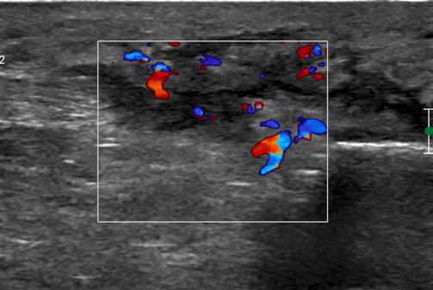
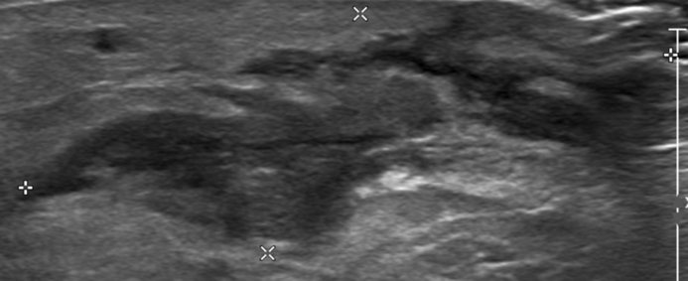
Today Ultrasound ( 12 days post second surgery)

Slide 5
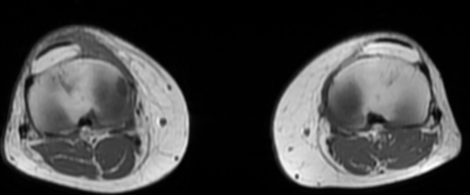
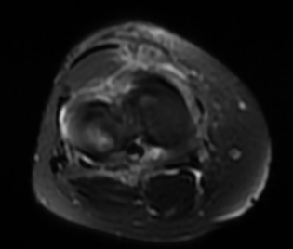
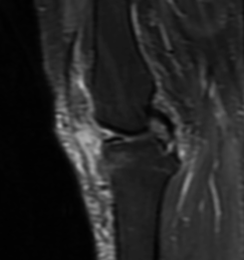
Today MRI ( with IV contrast)

Slide 6
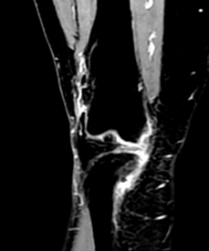
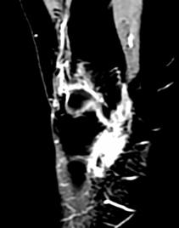
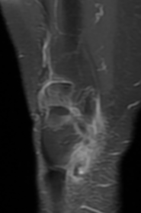
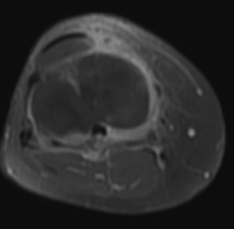
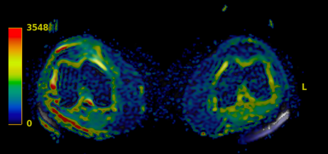
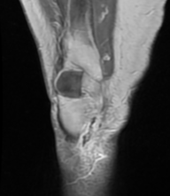
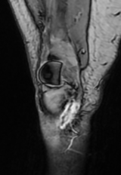
Post gadolineum
In phase
Out phase

Slide 7
Can I have your opinion and expertise on these case.
What’s your sugestion?
Thank you from Costa Rica.

