Slide 1
50 year old female
past medical history of breast cancer treated wih chemo, radiation and surgery.
Arm pain
Lesion is hot on bone scan
What do you think about this lesion?
Would you biopsy ?

Slide 2
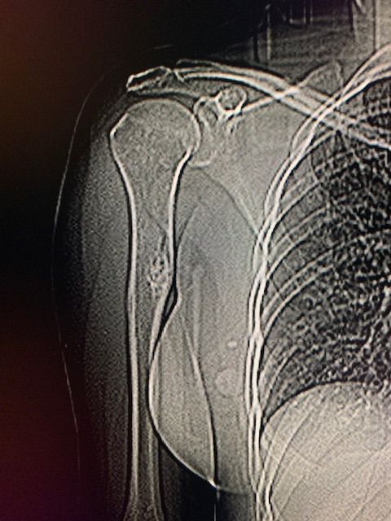

Slide 3
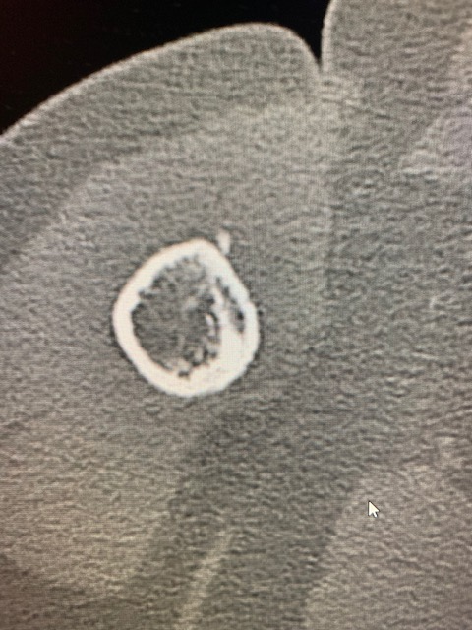
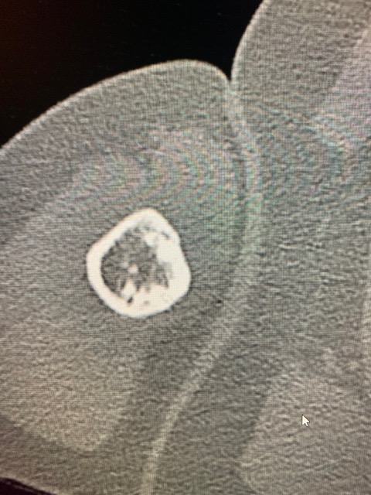
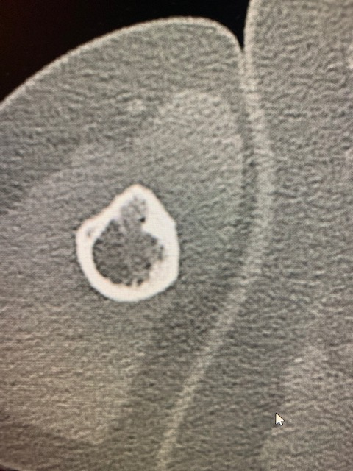
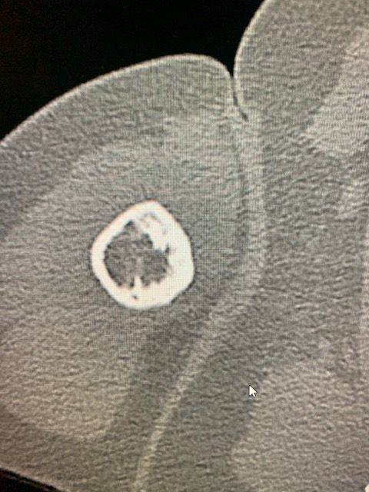

Slide 4
