Slide 1
27 YEAR OLD FEMALE
PAIN DISTAL FOREARM. NO FEVER, NO REDNESS. CBC normal
NO RELEVANT PAST MEDICAL HISTORY.
SIMILAR EPISODE TWO MONTHS AGO THAT IMPROVED WITH NSAIDS.
She said that 2 days ago her arm was more swollen.

Slide 2
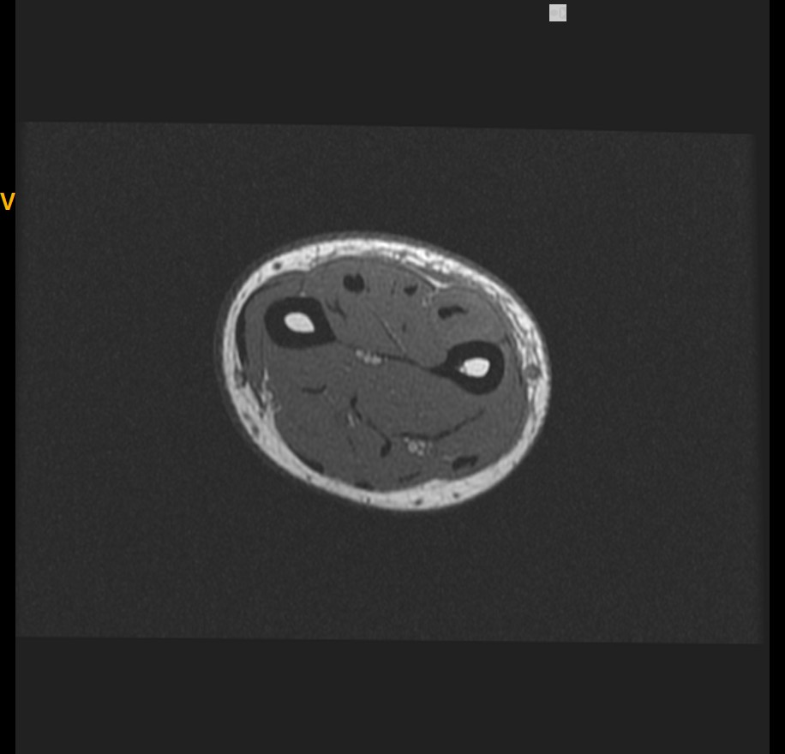
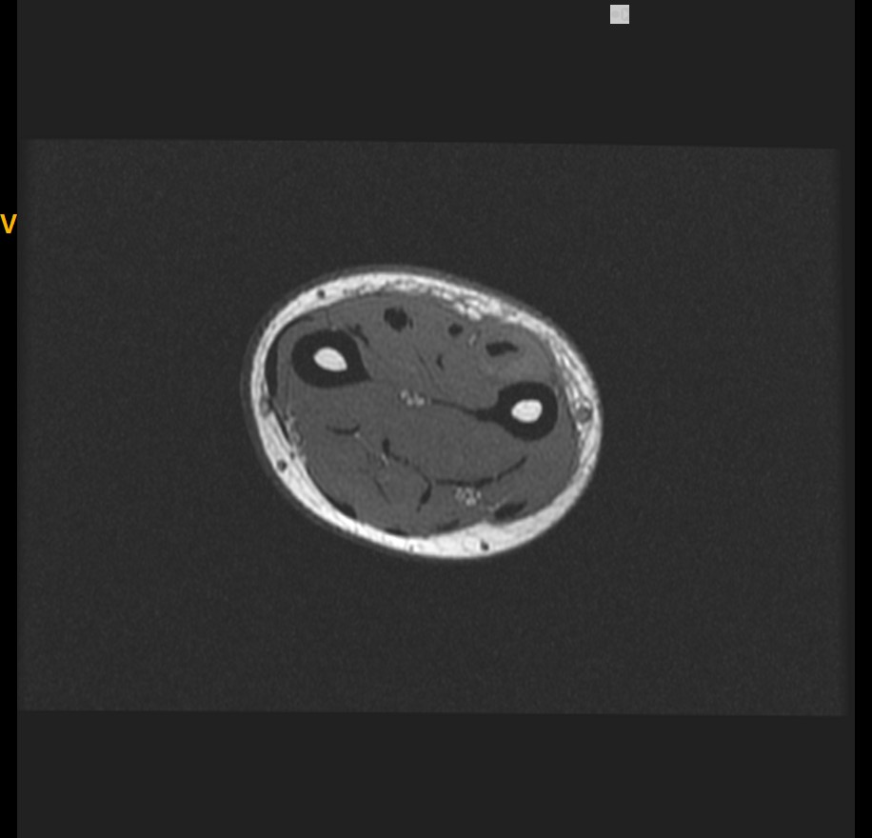
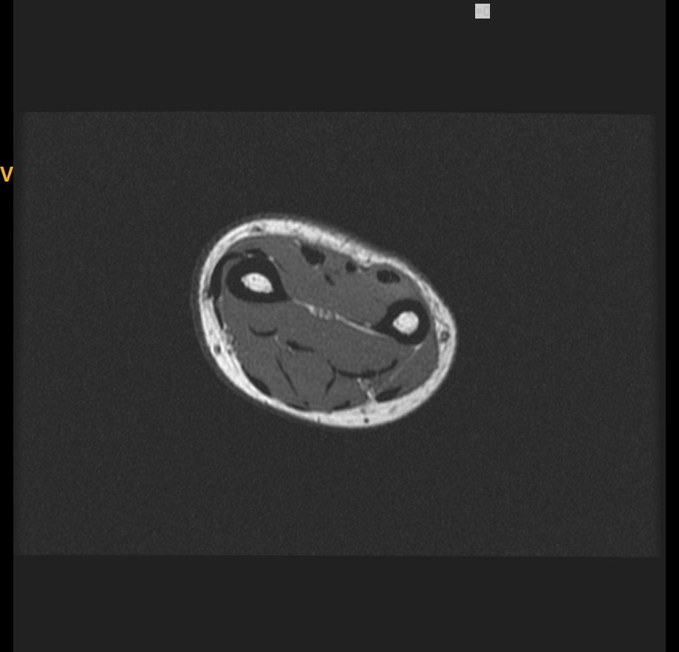
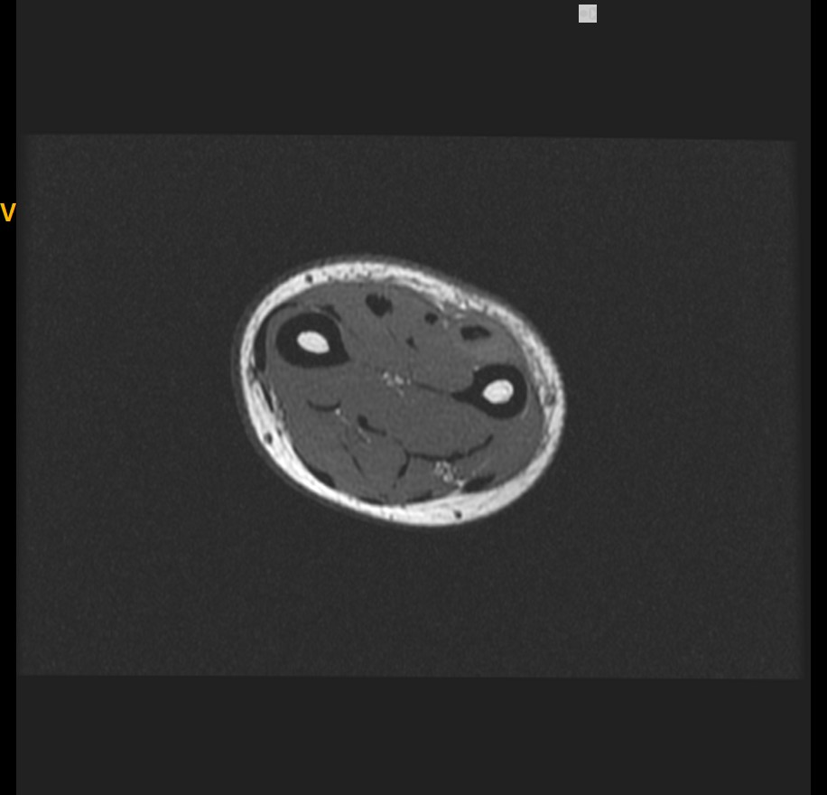

Slide 3
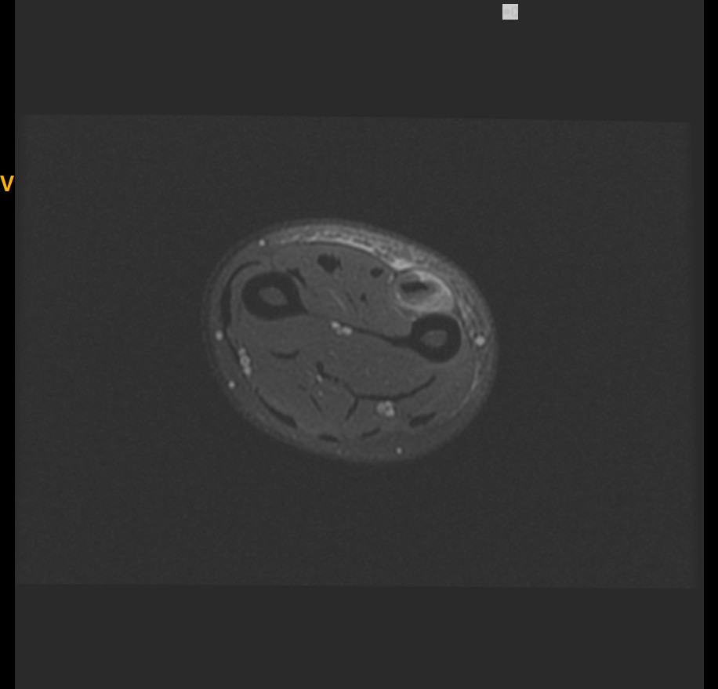
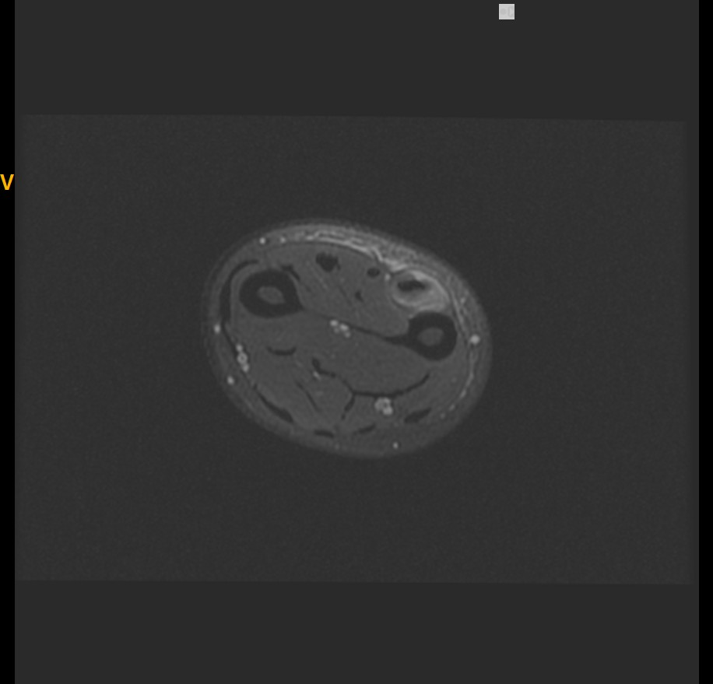
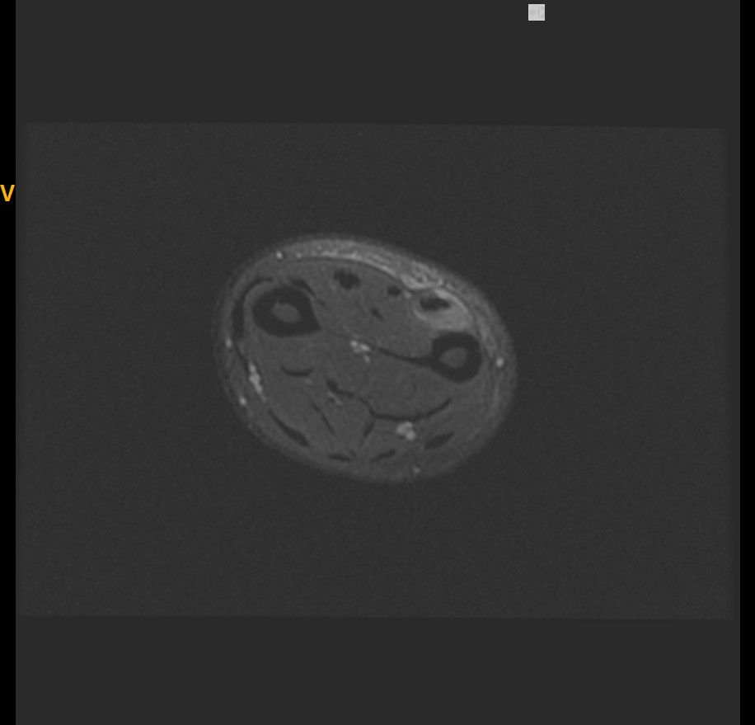
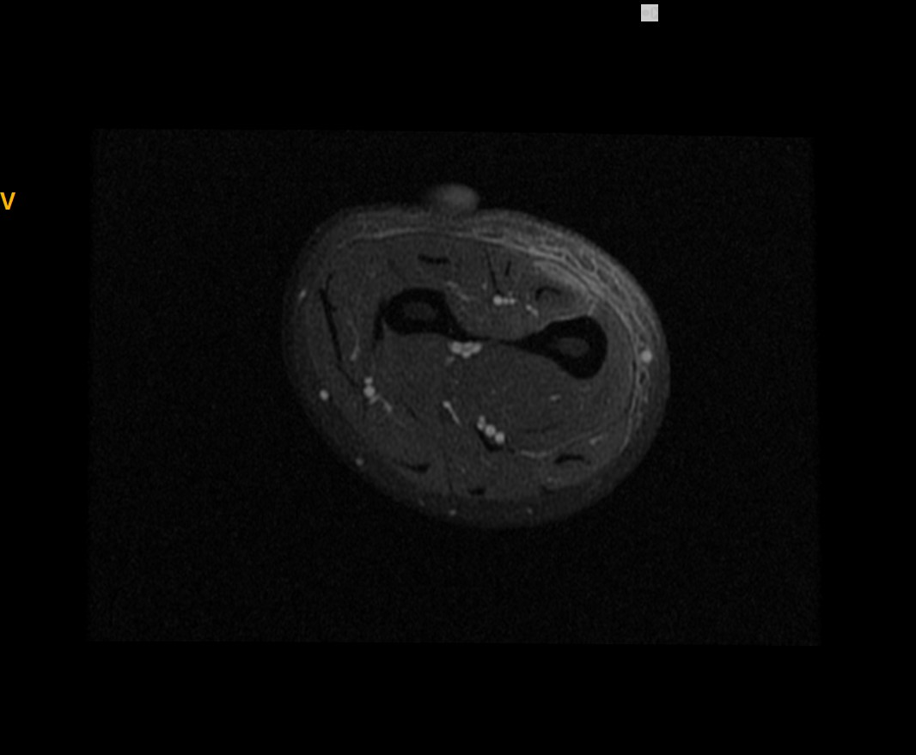

Slide 4
