Slide 1
31 year old female
Trauma
Posteroinferior fracture distal fibula; syndesmotic ligaments intact; lateral collateral ligaments without rupture; PTibFib, CalcFib and sup. peroneal retinaculum still attaching at the fragment
What kind of trauma leads to such an injury?
How would you classify it?

Slide 2
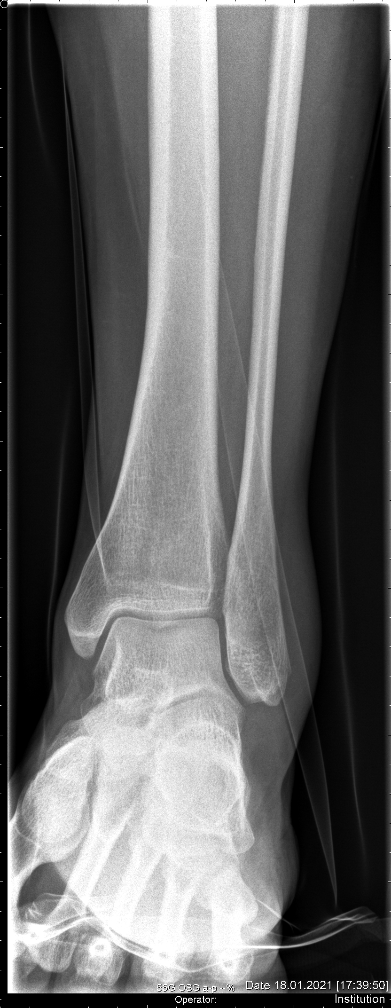
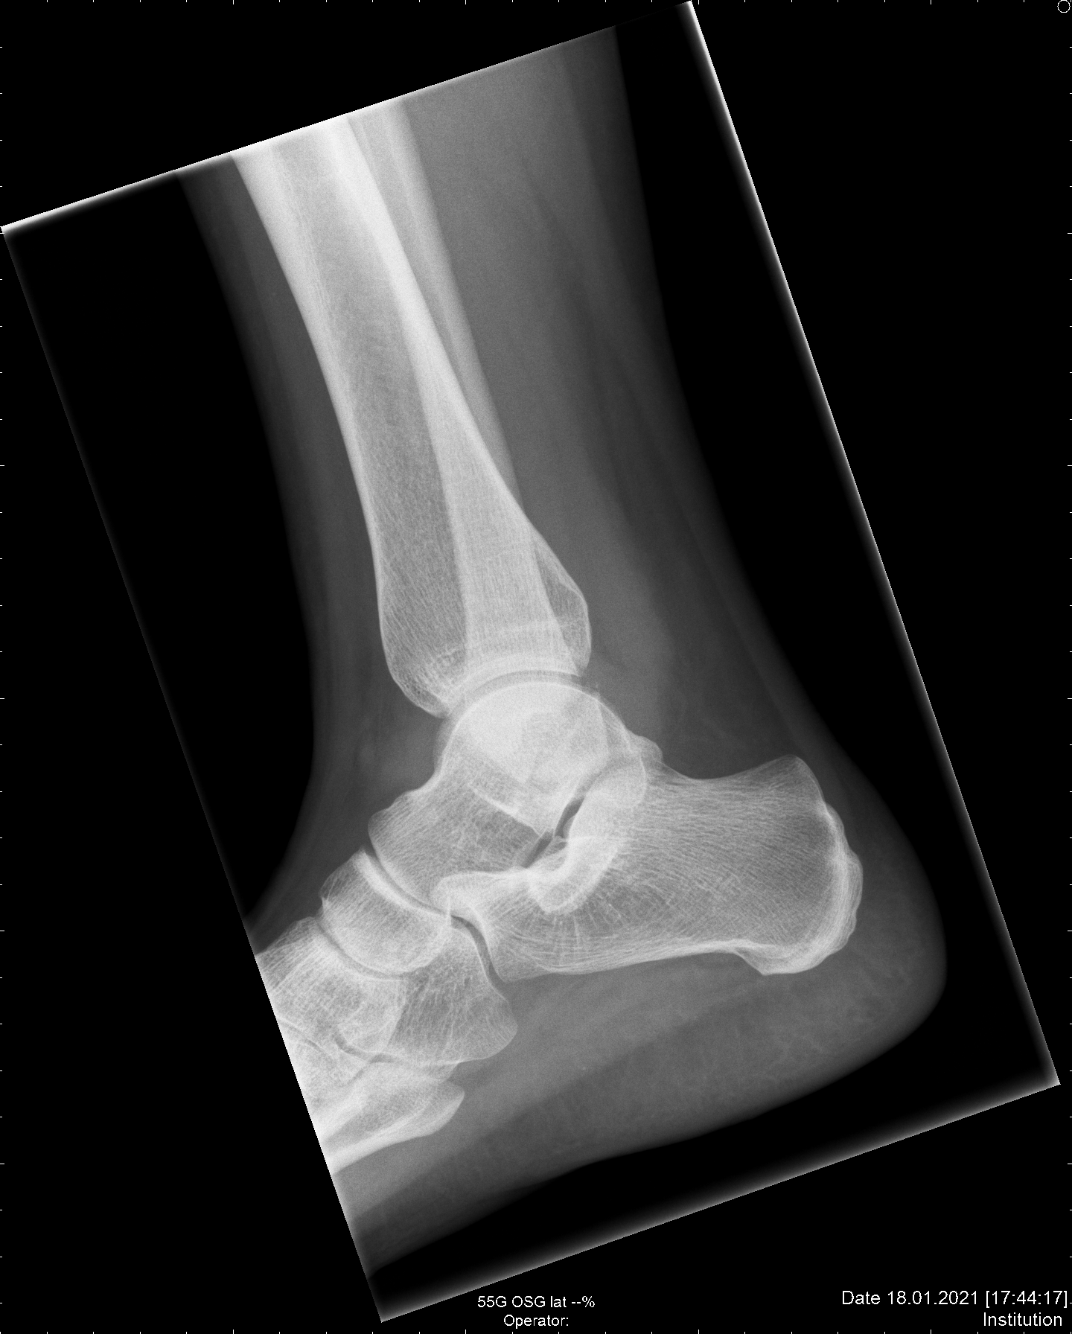

Slide 3
