Slide 1
50 Female with pelvic pain since 2019
Daniel Amirhamzeh, M.D. Beverly Tower Wilshire Advanced Imaging Center
8750 Wilshire Blvd Suite 100
Beverly Hills, CA 90211
Phone: 310.689.3100

Slide 2
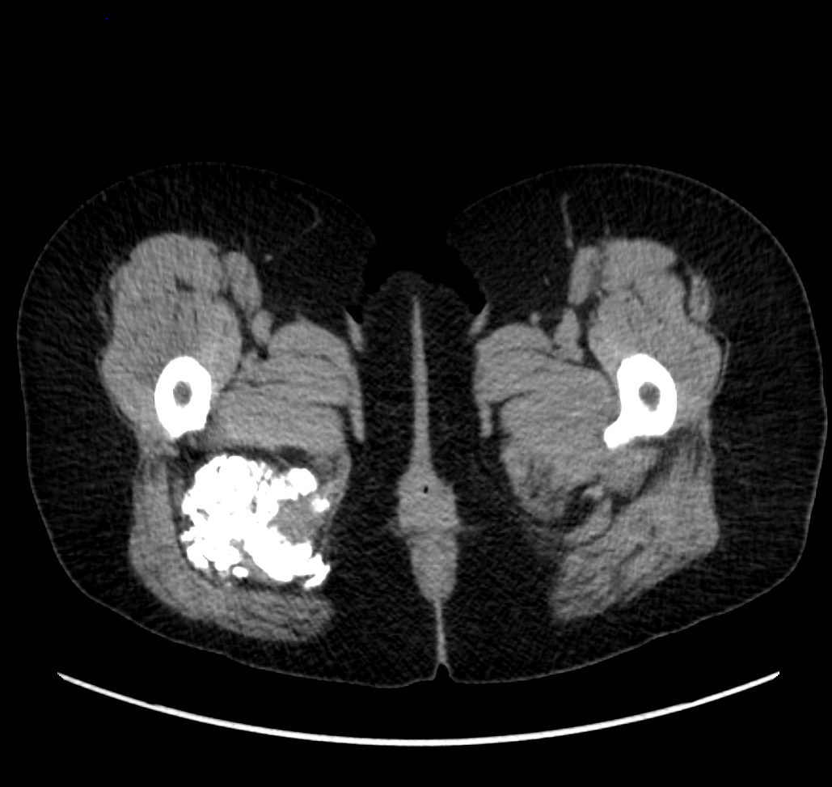

Slide 3
PET-Scan
SUV uptake of 4.7
Mildly elevated CA 15-3 tumor marker

Slide 4
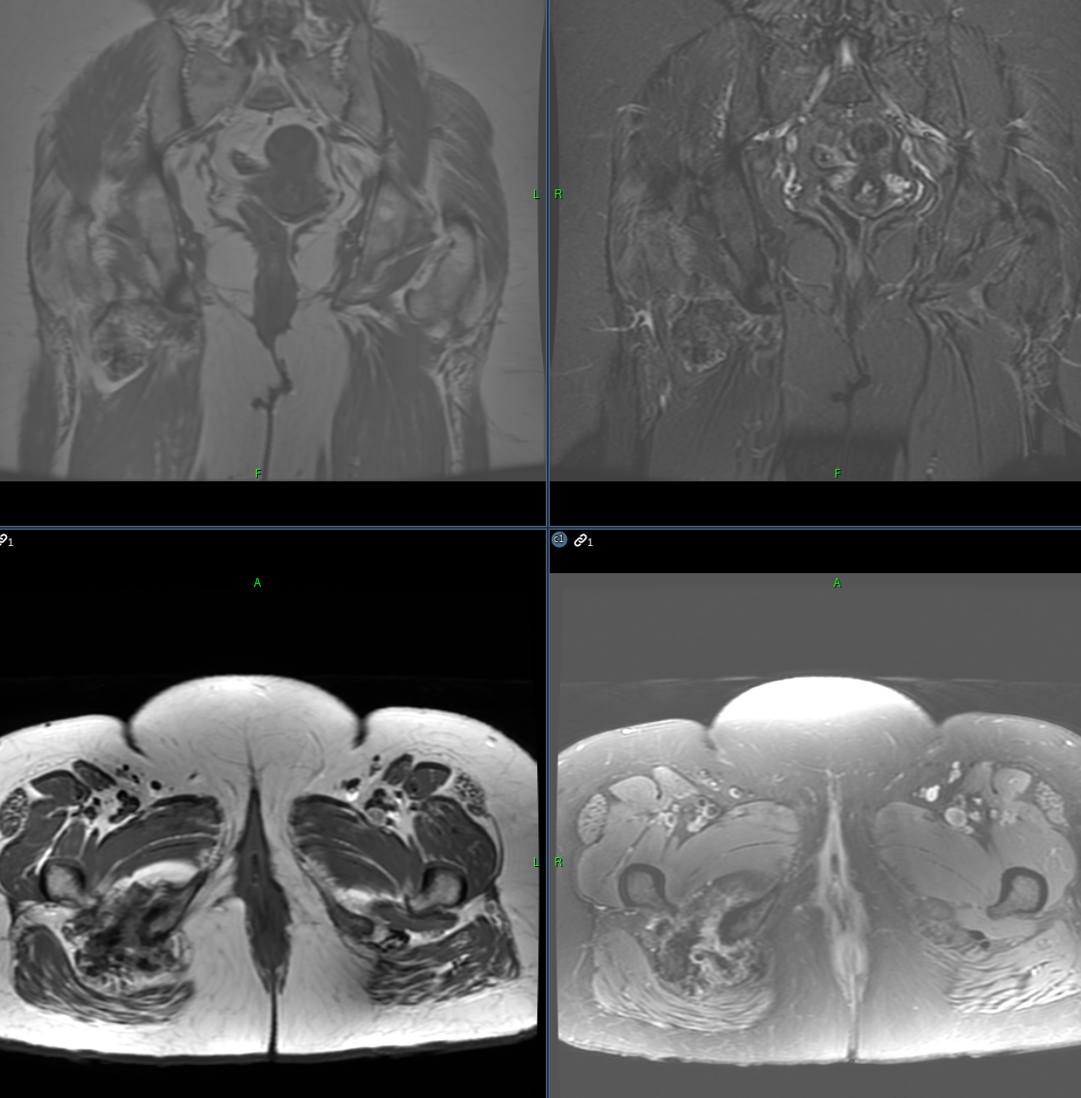

Slide 5
DDx
Myositis ossificans versus heterotopic ossification (Periarticular manifestation of melorheostosis)
Paget disease?
Tumor calcinosis
High-grade surface osteosarcoma
Juxta-cortical chondrosarcomas
Synovial Sarcoma

