Slide 1
42 yo man with longstanding back and pelvic/perineal pain. History of transrectal botox injection into levator ani.
Thank you for any help!

Slide 2
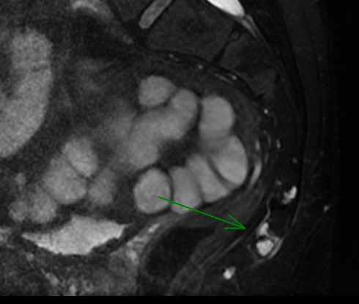
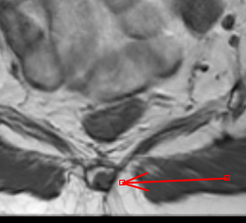
T2 FS
T1
The arrows correspond to the same lesion. The other T2-hyperintense lesion above and below this were showed similar T1 characteristics but not as clearly demonstrated

Slide 3
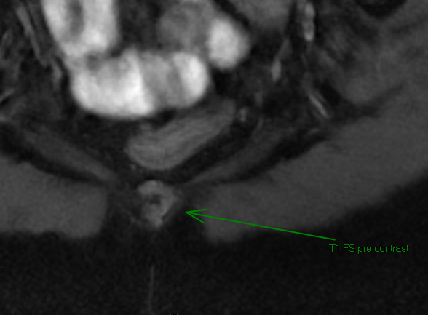
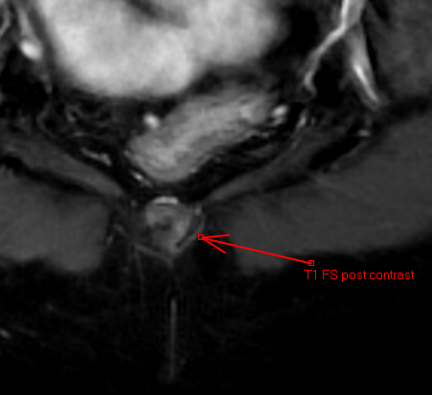
Here’s the largest lesion (same as arrows above) pre and post contrast. It’s subtle but there does appear to be some enhancement when I measure the intensities

Slide 4
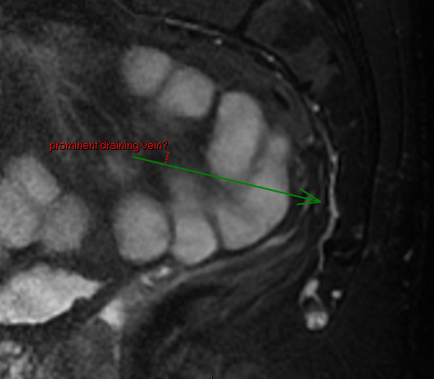
Not sure if this is real/relevant, but there might be a prominent draining vein to the largest lesion?

