Slide 1
38 years old Female Medial clavicle uptake on bone scintigraphy. Refers no pain Don’t know why realized scintigraphy

Slide 2
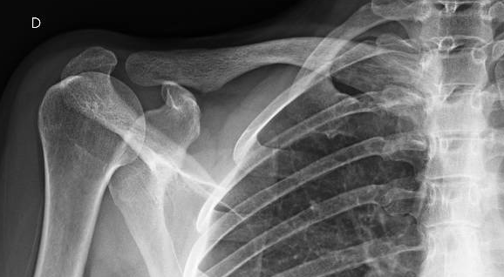

Slide 3
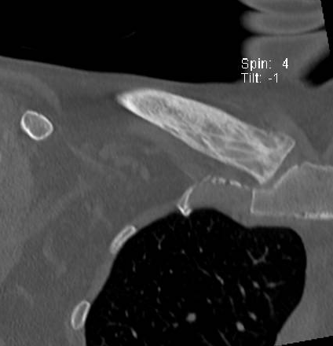

Slide 4
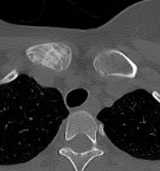

Slide 5
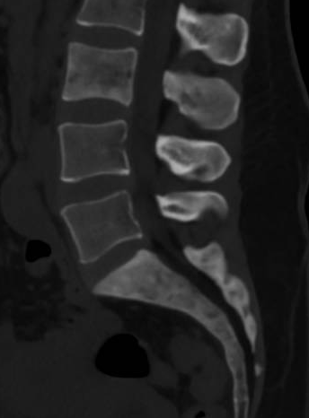

Slide 6
Any help?

