Slide 1
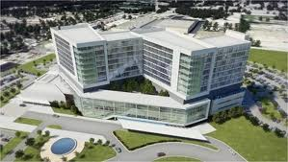
Quiz

Slide 2
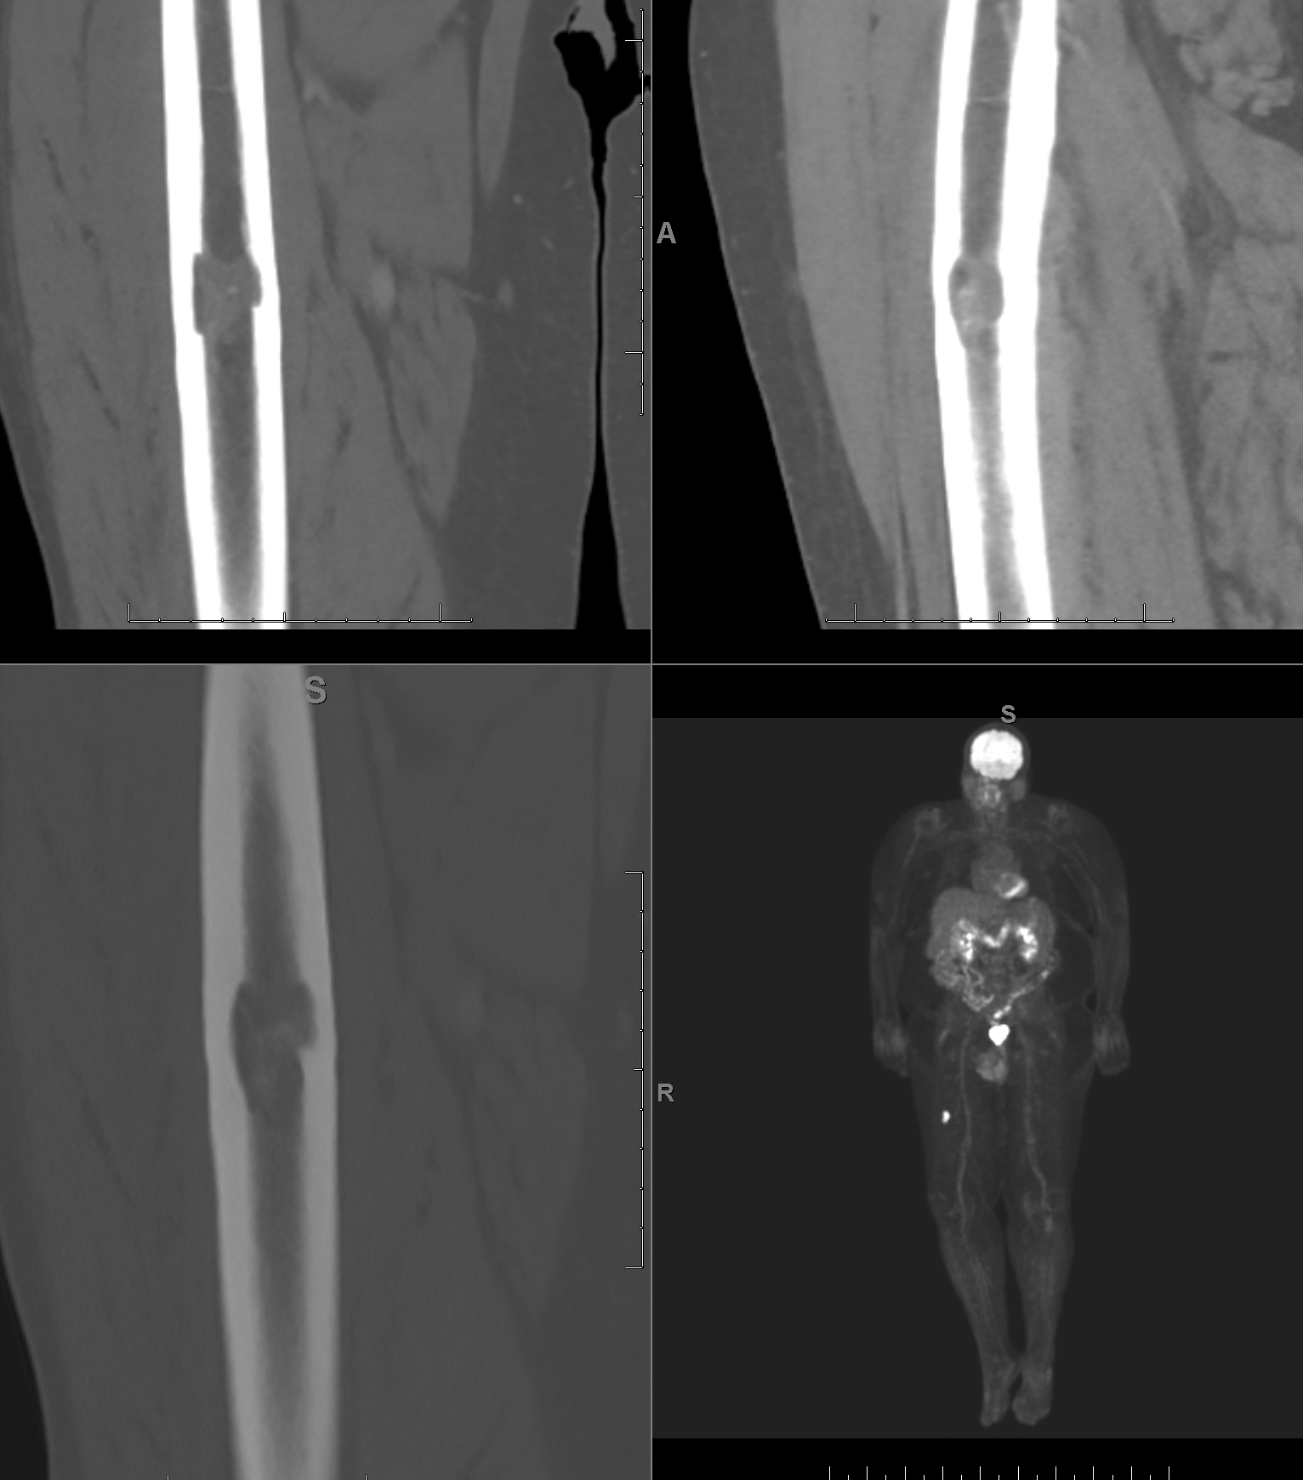
Middle aged man
Notes:
Integrative, performance, relationship, internal

Slide 3
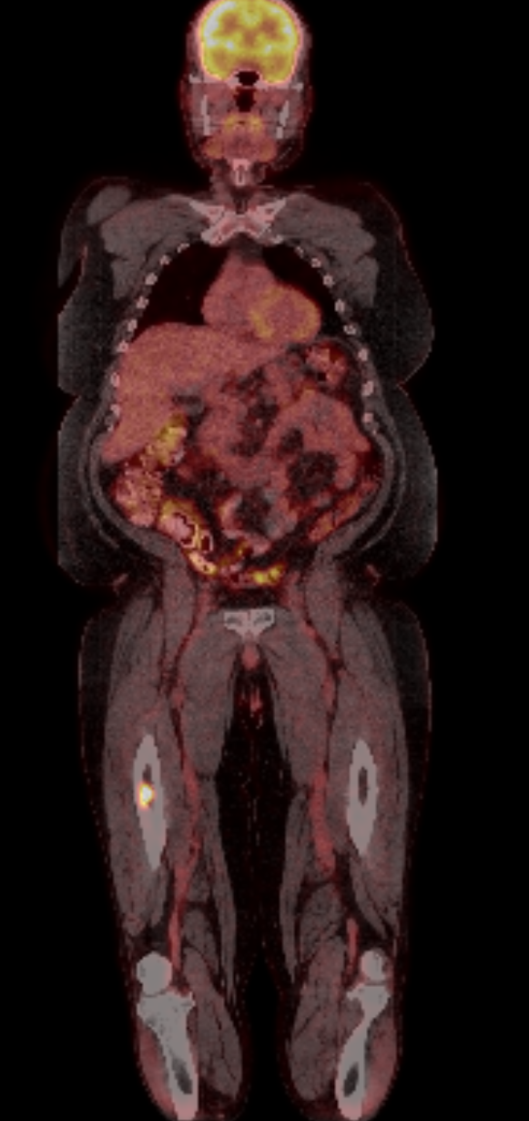
Diagnosis?

