Slide 1
Wrist USG
H/o :-Tingling and pain along median nerve distribution after minor trauma.

Slide 2
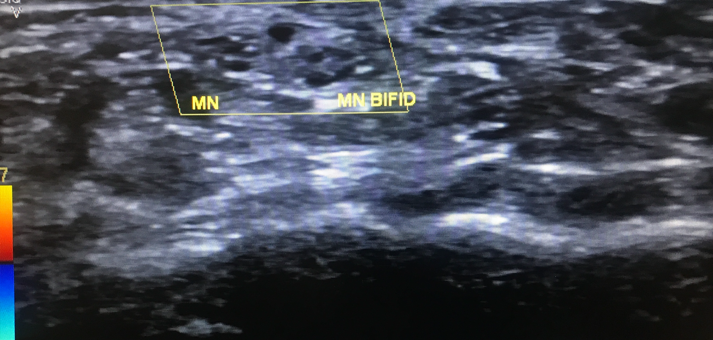
BIFID MEDIAN NERVE

Slide 3
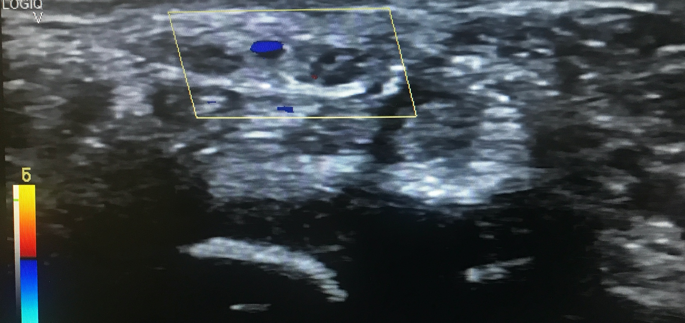
Persistent median artery with bifid median nerve

Slide 4
Thrombosed median artery at proximal carpal row

Slide 5
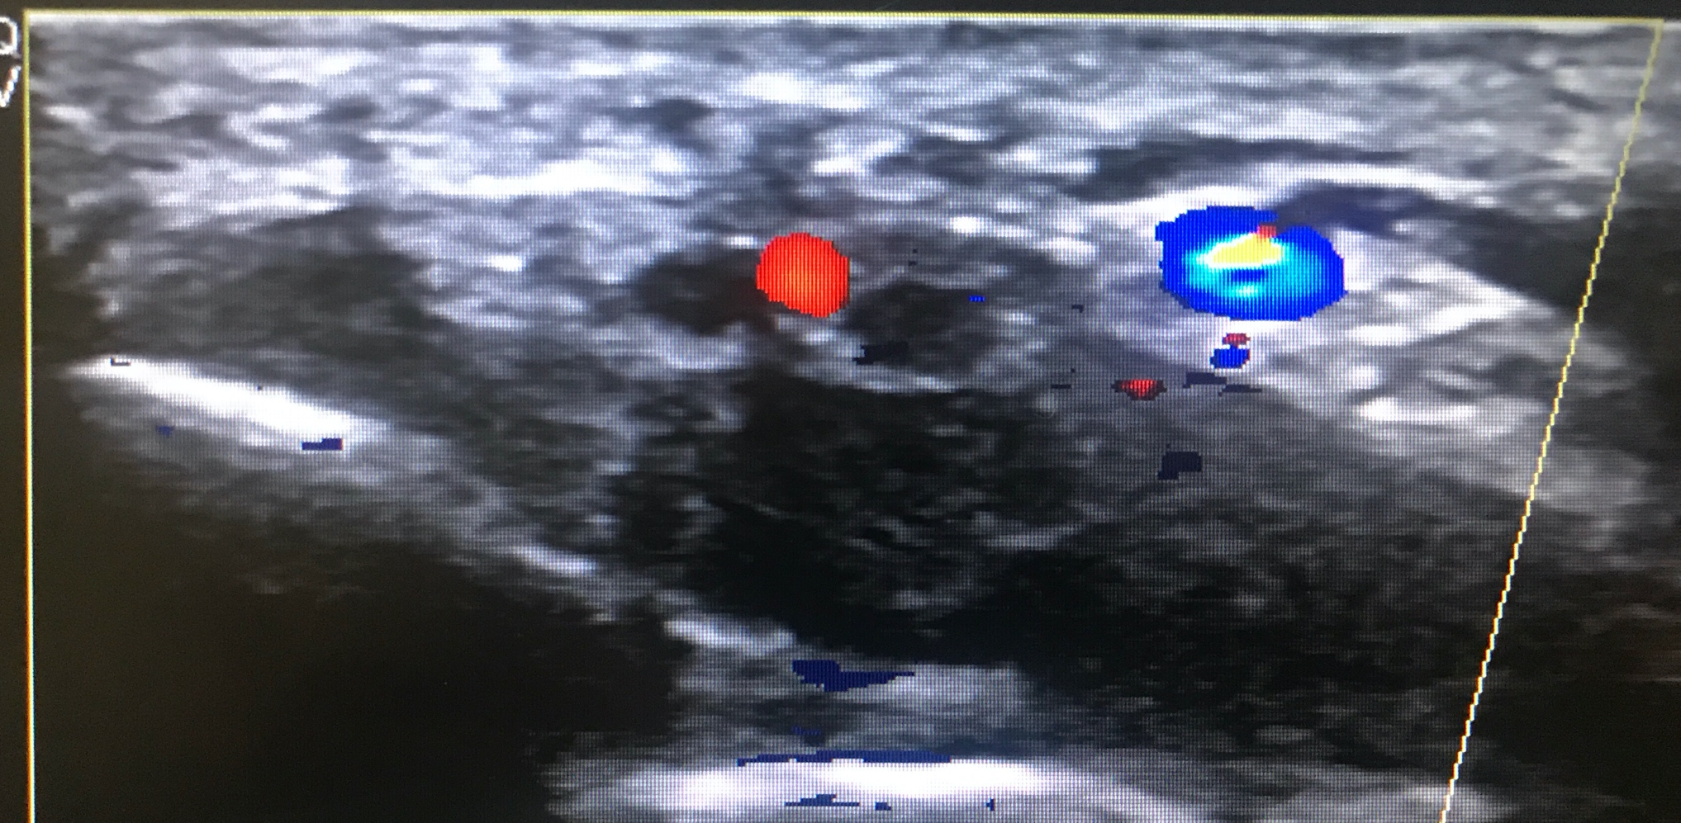
Contralateral wrist proximal carpal row

Slide 6
Thrombosed persistent median artery

Slide 7
CTS secondary to thrombosed persistent median artery and associated bifid median nerve

