Slide 1
History:
52 year old woman
Growing pulpable lump over deltoid muscle since 1 week
No history of injury, injection, vaccination or insect bite in the last few months at this location
Not very painful
Clinically no perifocal inflammation

Slide 2
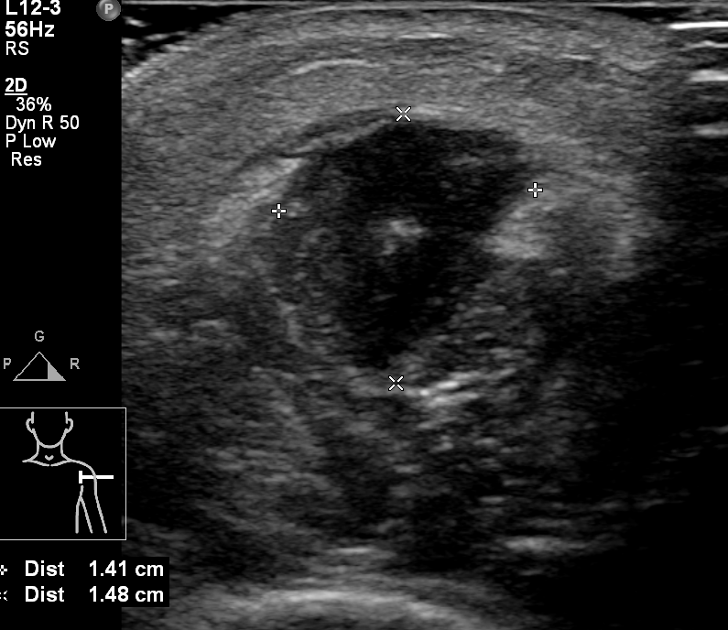
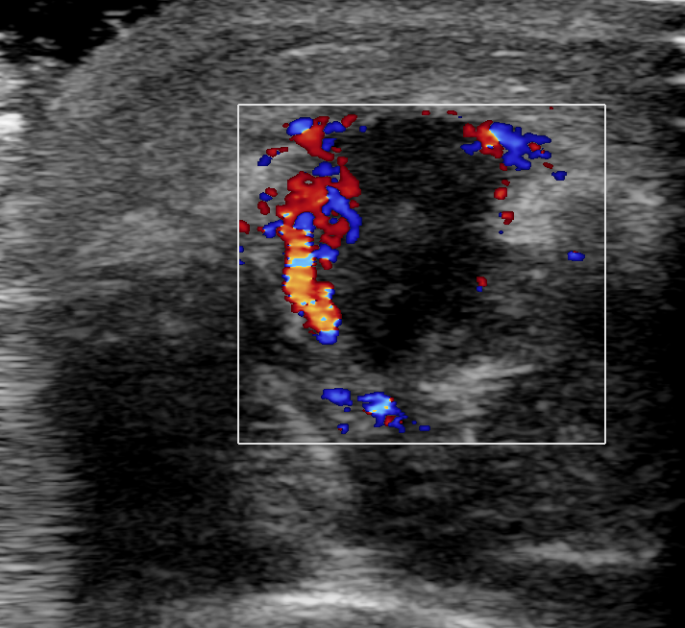
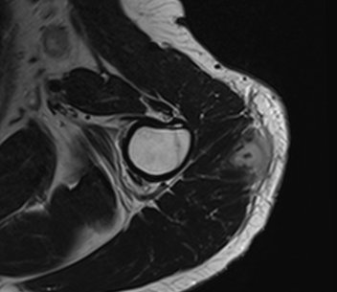
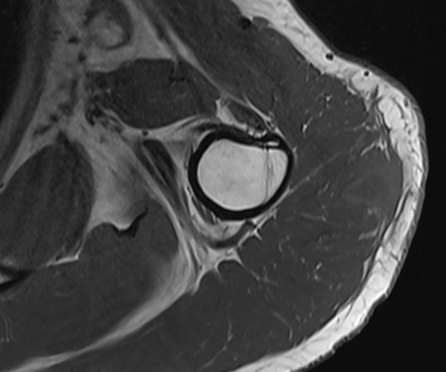
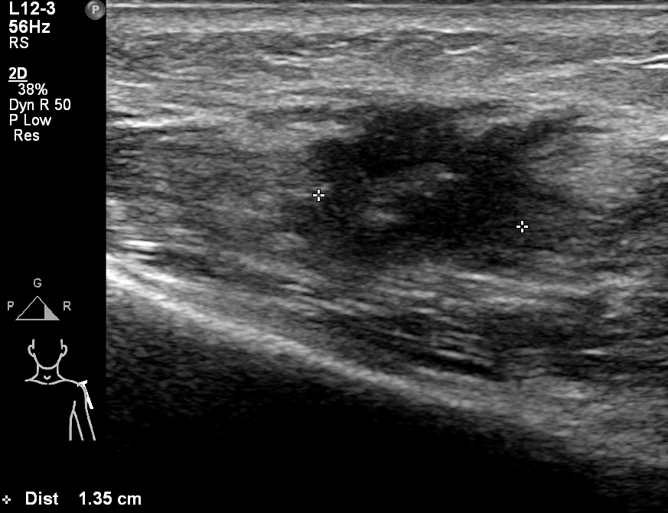
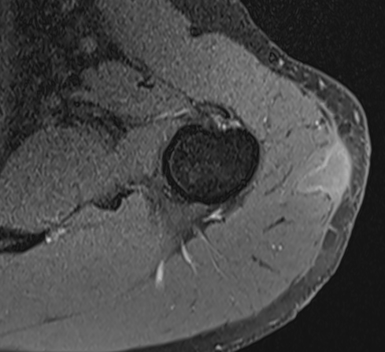
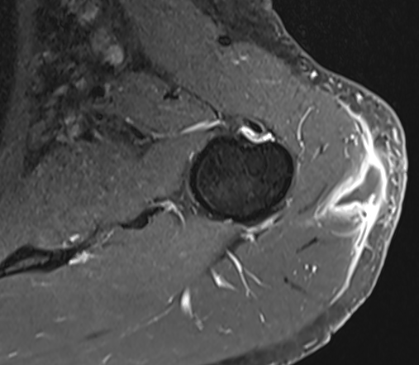
ax T2
ax T1
ax T1 fs
ax T1 fs + c

Slide 3
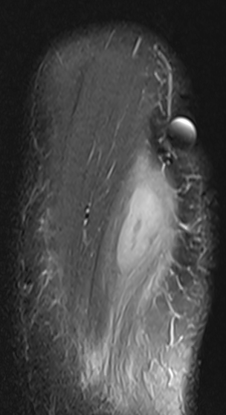
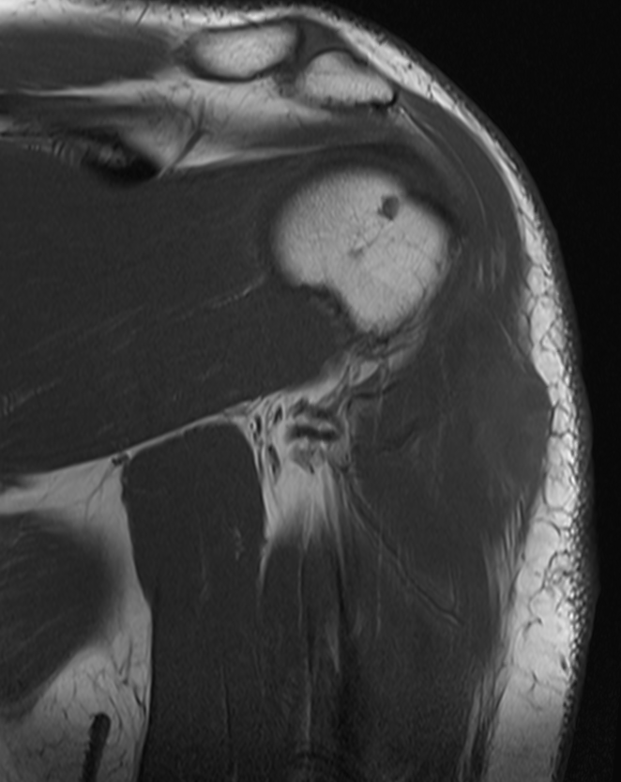
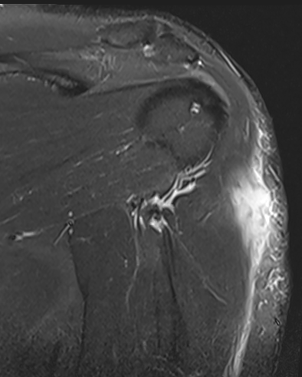
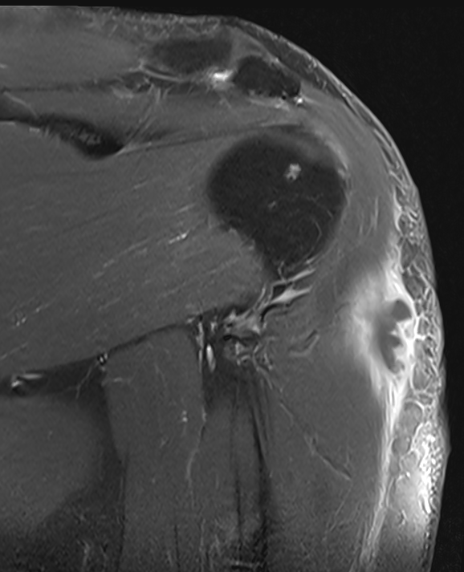
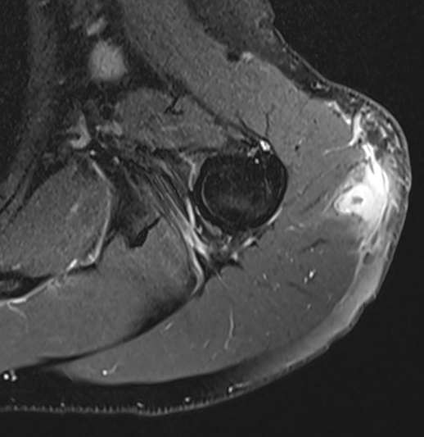
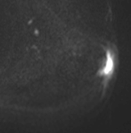
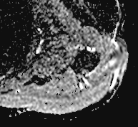
sag PDfs
cor STIR
cor T1 fs + c
cor T1
ax PD fs
ax B800
ADC

Slide 4
Questions:
Can this be an abscess despite the missing history of trauma, injection…?
Is this a foreign body within the center of the lesion? What else could this be?
Could this be a neoplastic soft tissue tumor, with necrotic center? If yes what is the most propable diagnosis? (Epithelioid sarcoma? Nodular fasciitis?)
What are the next steps? Biopsy? Sonographic follow-up in a few weeks?

