Slide 1
50 yrs old man having backache

Slide 2
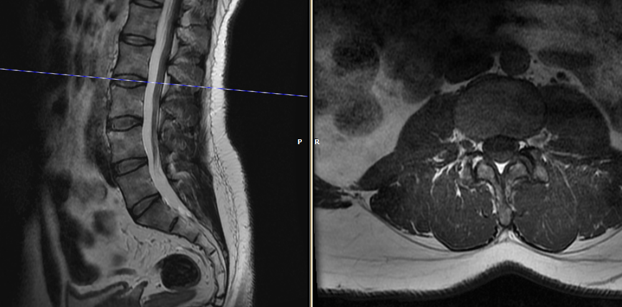
What is the cause of hyperintensity in right L3-4 facet joint? Trust me I have seen this several times.
Please enlighten

Slide 3
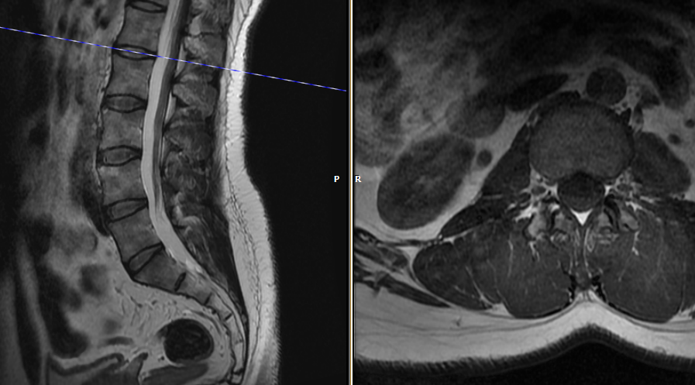
To a lesser degree at L2-3 also.

Slide 4
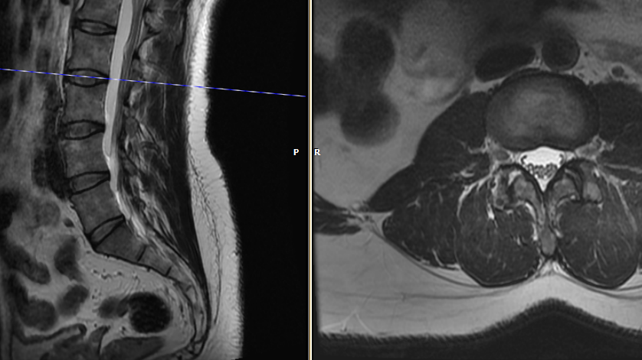
T2

