Slide 1
OCAD CASE
FEMALE, 58 Years old
Pain in right leg
Breast cancer in 2016
Cláudio Régis Silveira, MD
Matheus Cavalcante, MD
São Carlos Hospital, Fortaleza, CE, Brazil

Slide 2
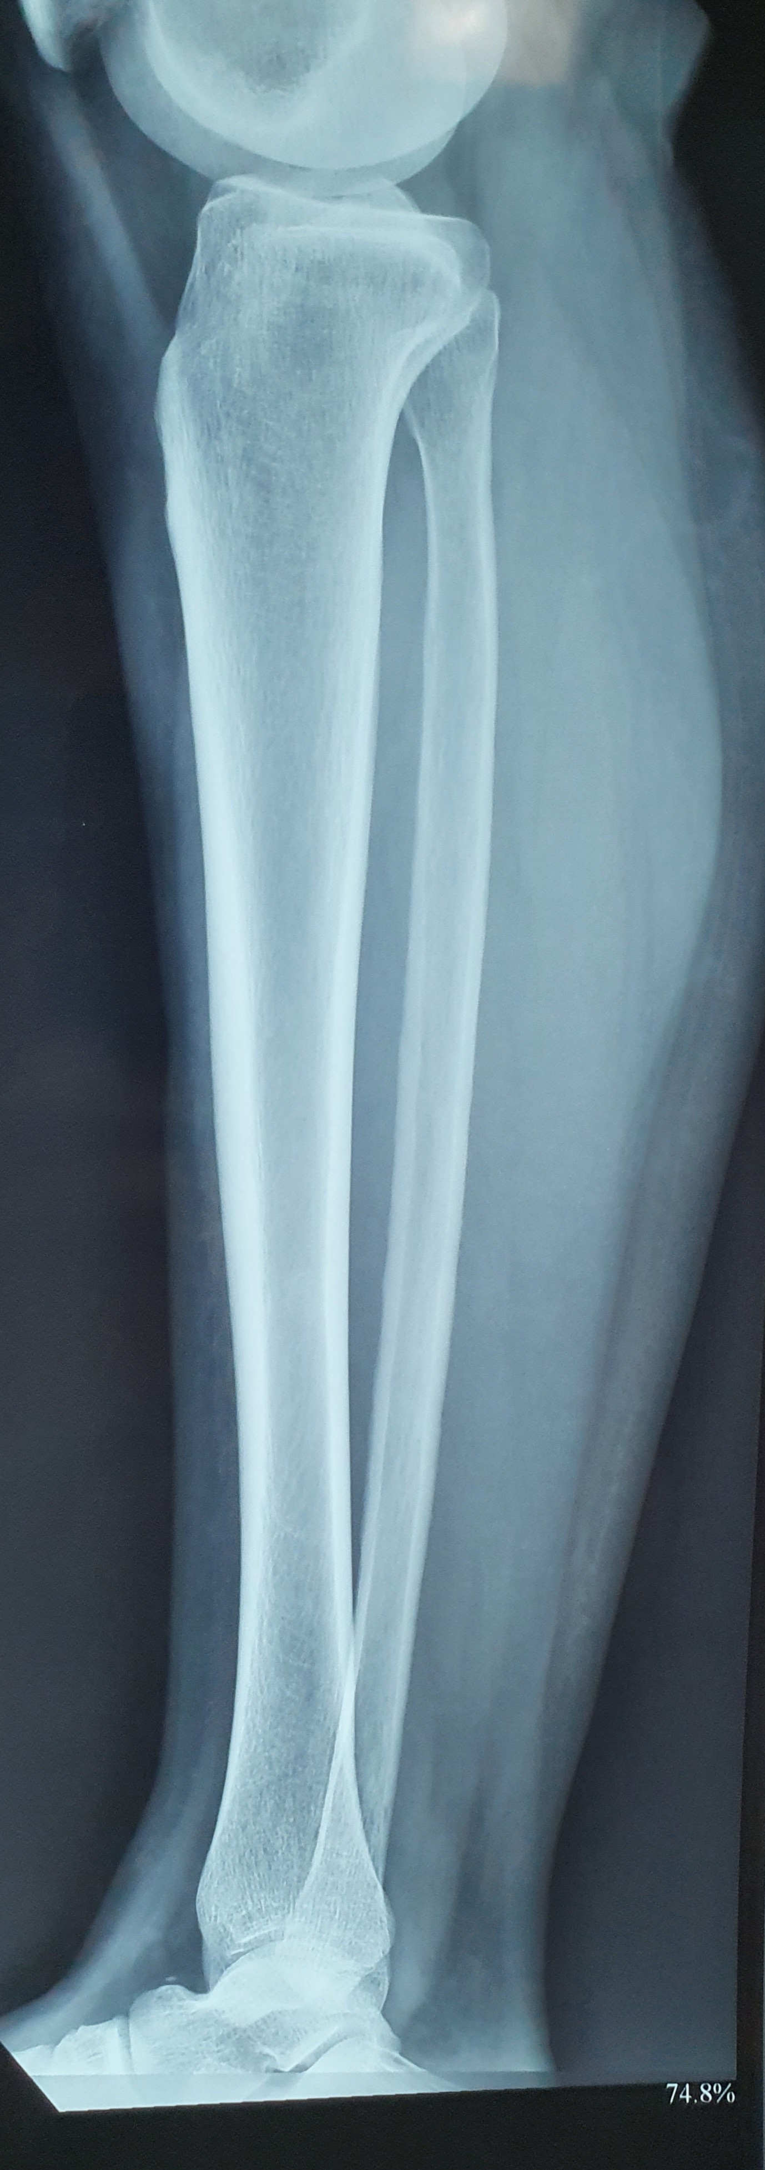
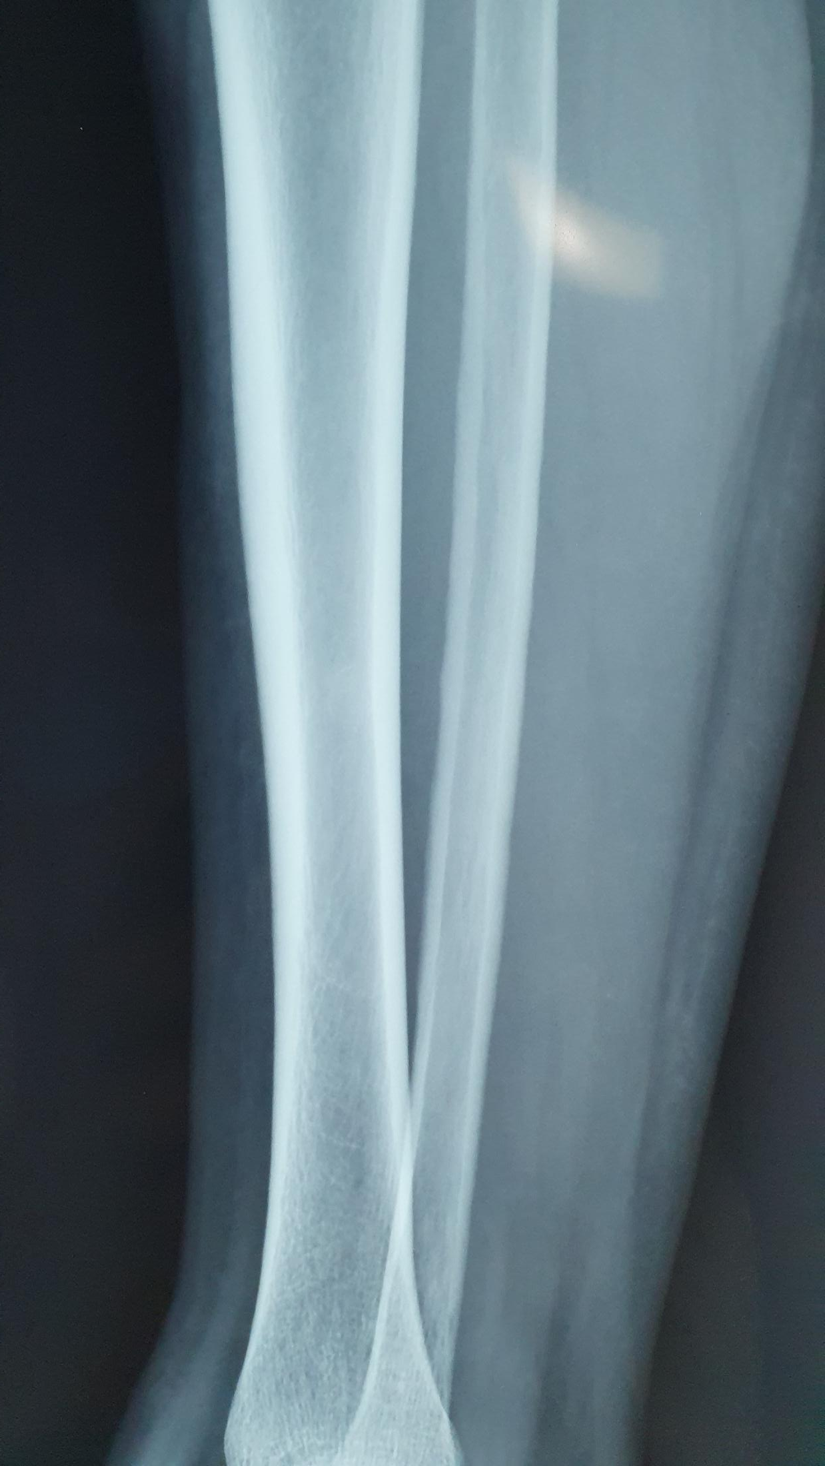
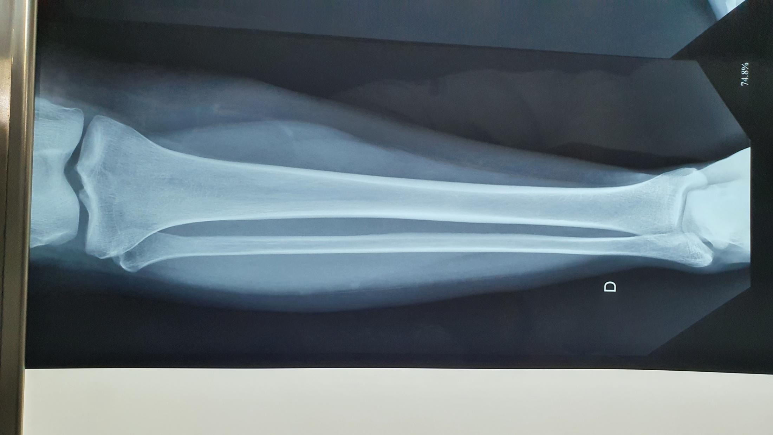
x-ray
xray reported as normal

Slide 3
MRI
T1
STIR
cutaneous marker very close to bone lesion

Slide 4
MRI - T1 gad

Slide 5
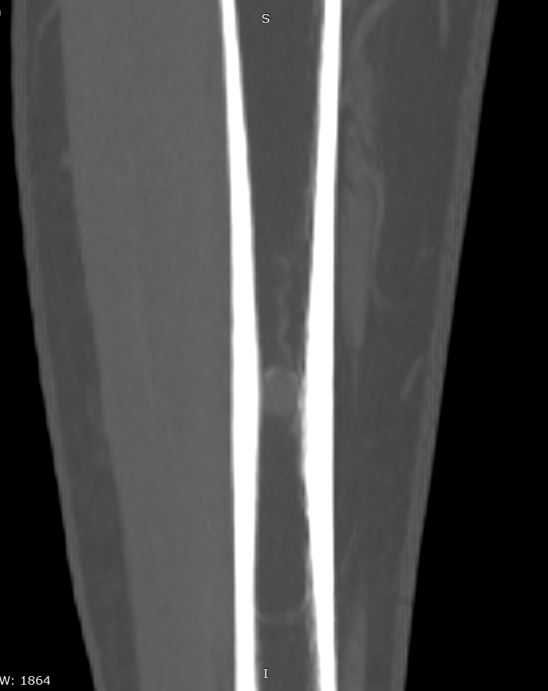
CT pre contrast
MIP

Slide 6
CT post contrast

Slide 7
Coments
- Pacient has previous MRI from 07/06/2019 that shows stability
- At that time she also had a gastrocnemius strain, so bone lesion was incidental?
- Now, more than a year later, she remains with pain (cutaneous marker close do bone lesion)
- DWI / ADC not available.

Slide 8
Hypothesis?
Low grade vascular lesion?
Bone Hemangioma?
Touch or Do not touch lesion?

