Slide 1
1 year old boy.
PAIN ON PALPATION

Slide 2
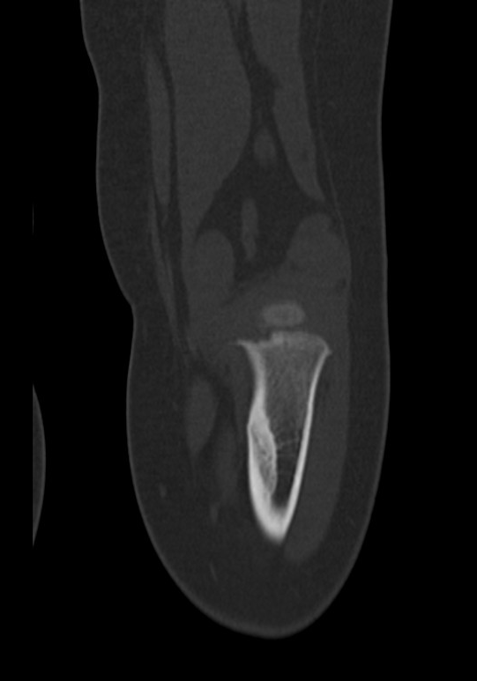
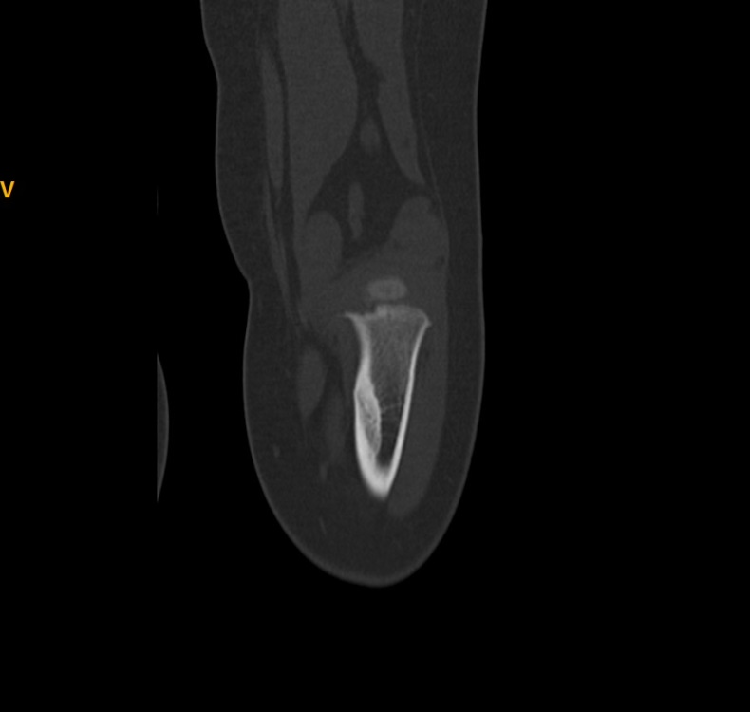

Slide 3
