Slide 1
40 year old with knee anterior Pain
Knne MRI shows mild chondrosis and fat inpingement
I read the RX as possbile enostosis/non-agressive fibro-osseous lesion
Does this hiperintense halo put you off?
Does it need further work up?
thanks

Slide 2
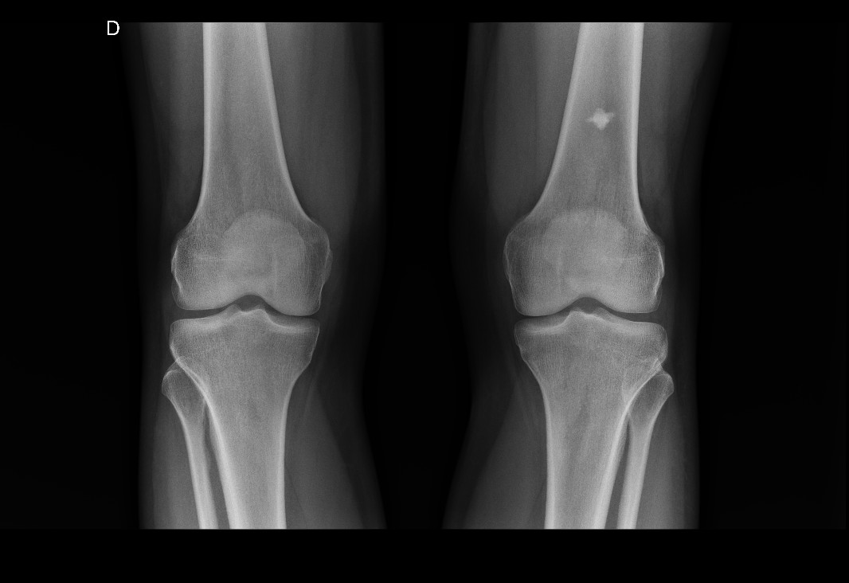

Slide 3
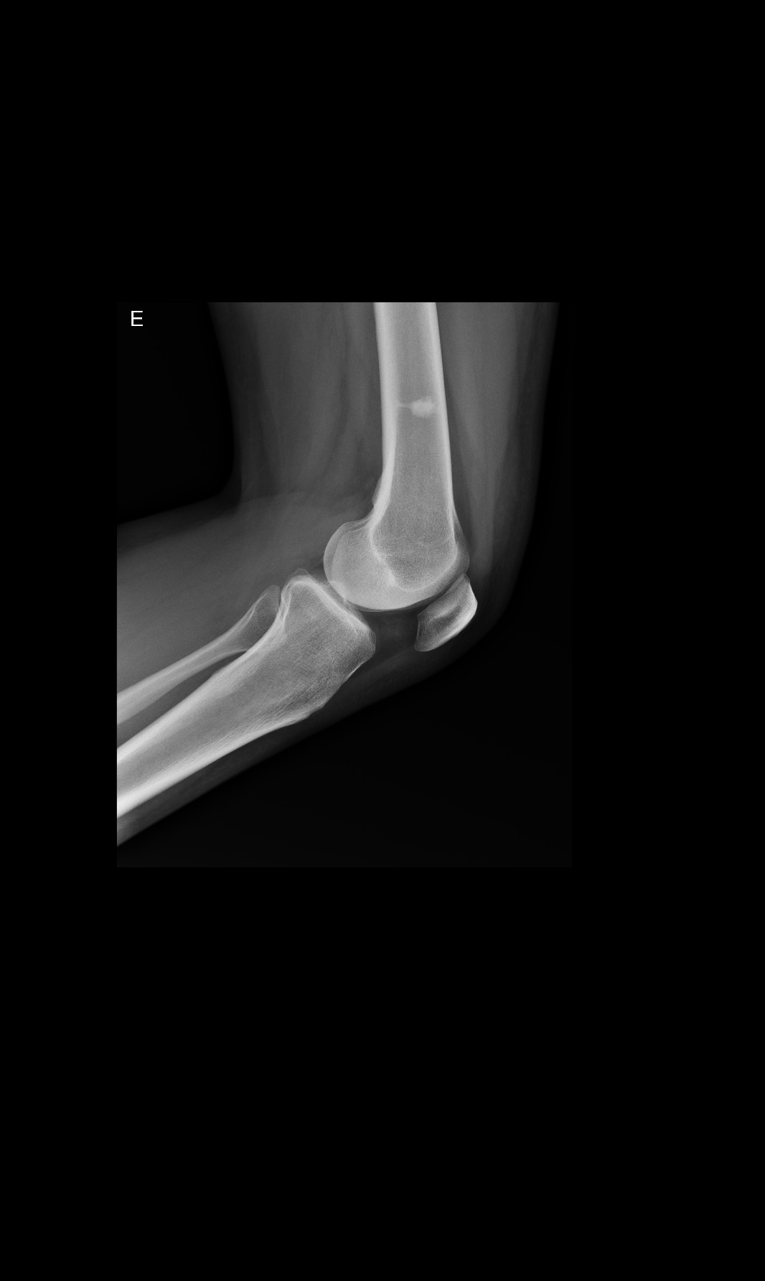

Slide 4
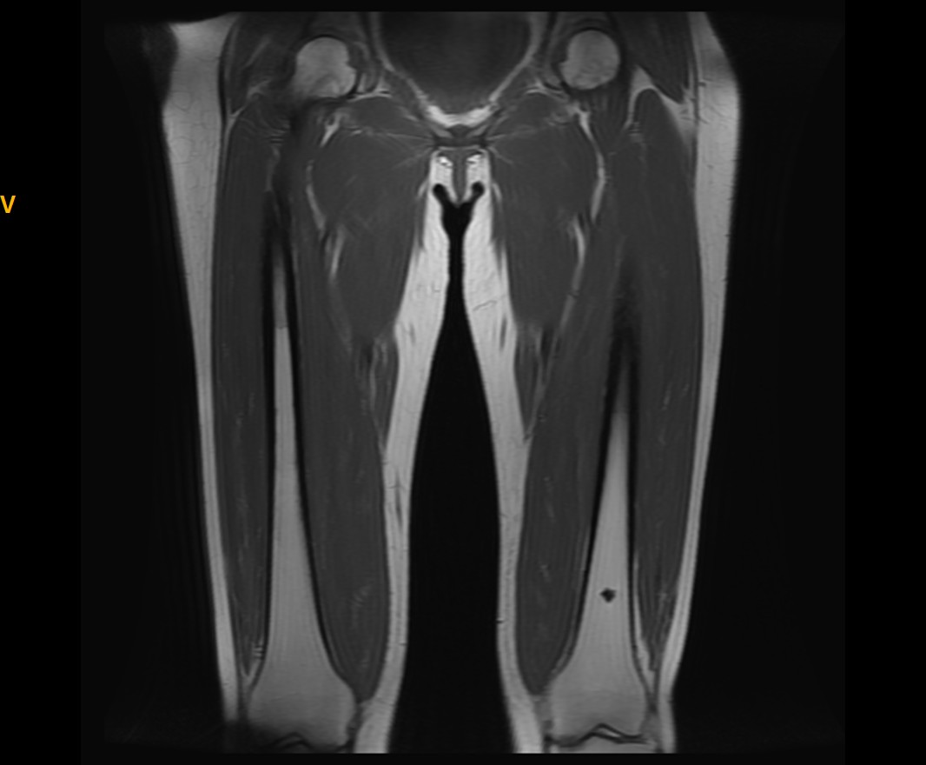
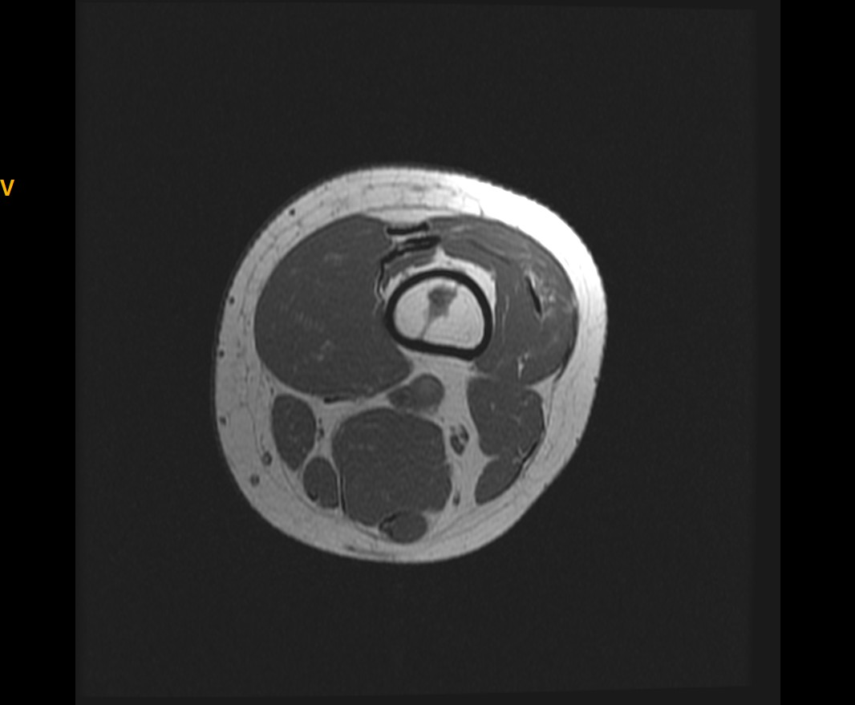

Slide 5
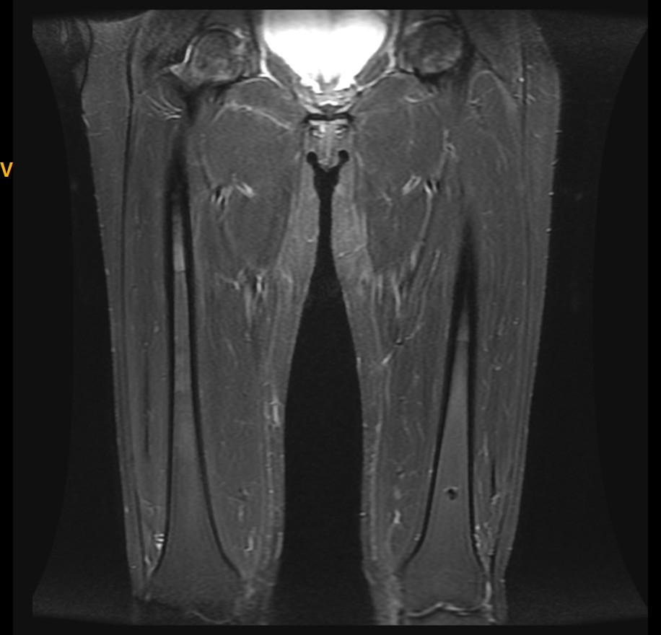
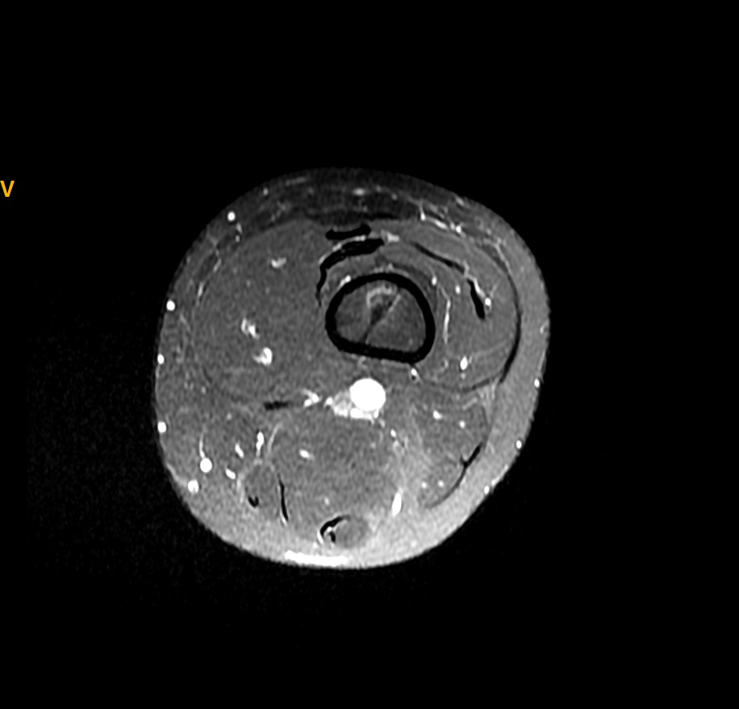

Slide 6
