Slide 1

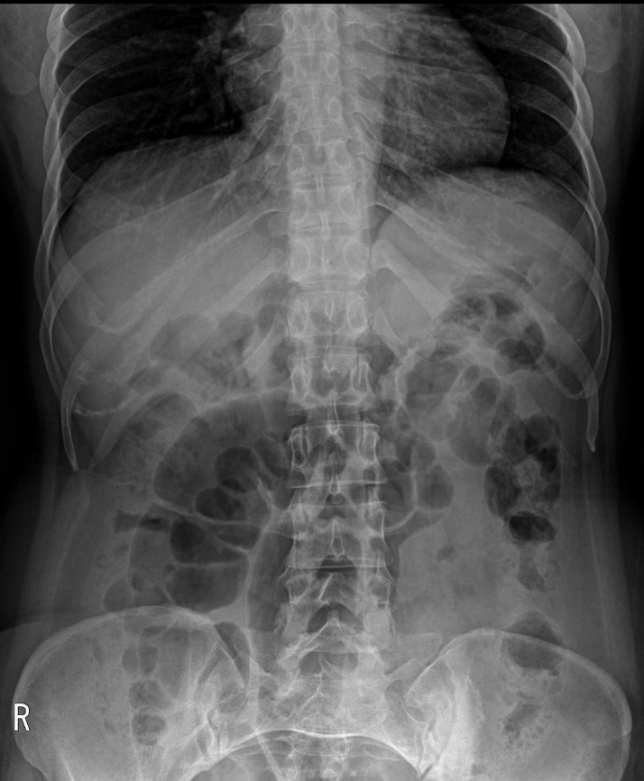
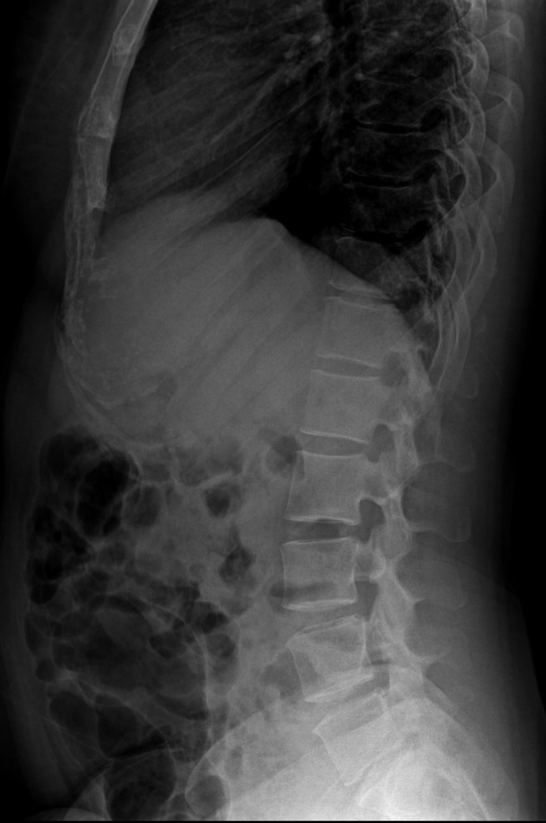
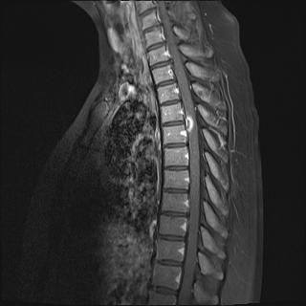
43/F
Sudden Left lower leg sudden
Courtesy of
HeeSuk Chung
mediknight@hanmail.net

Slide 2
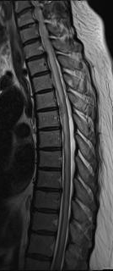
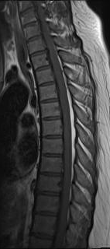
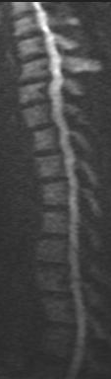
T2WI
T1WI
DWI
T1WI C+

Slide 3
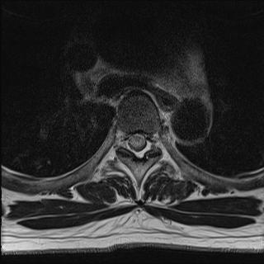
T2WI

Slide 4
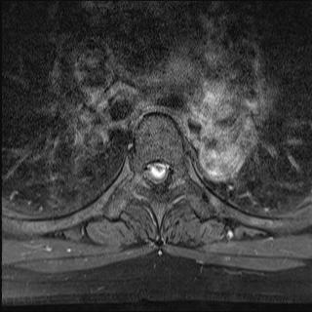
T1WI C+

Slide 5


Slide 6


Slide 7
Syphilitic myelitis
Lab
VDRL (CSF): 1:16 Positive
FTA-ABS IgG (CSF) : Reactive
TPLA (Blood) : Positive
FTA-ABS IgG (Blood) : Reactive
VDRL (RPR): Strong Reactive

Slide 8
Syphilitic myelitis
Eur Radiol (2002) 12:2973–2976
very rare manifestation of neurosyphilis.
caused by spirochete Treponema pallidum
central nervous system ☞ primarily affected in tertiary stage
(although it can be involved in any stage of the disease)
incidence of neurosyphilis ☞ 5–10% in untreated cases
clinical symptoms
: tabes dorsalis, spastic paraparesis and amyotrophy

Slide 9
Syphilitic myelitis
Eur Radiol (2002) 12:2973–2976
MR imaging(Tashiro et al. , first described (1987))
▶ T2-weighted images
: short segment high signal intensity
▶ gadolinium-enhanced images
: abnormal enhancement, predominantly in the superficial parts of the
spinal cord
⇒ meningeal inflammation and spinal cord ischemia
→ spinal cord lesions which have resolved completely following
treatment

Slide 10
Syphilitic myelitis
Eur Radiol (2002) 12:2973–2976
MR image
▶ T2-weighted images
☞ diffuse high-signal lesions involving the whole spinal cord
▶ gadolinium-enhanced images
☞ focal nodular enhancement
Diagnosis
☞ antitreponemal antibody test such as VDRL, FTA, or TPH ⇒ positive
Differential diagnosis
☞ idiopathic transverse myelitis, spinal cord infarction, ADEM, tumor,
sarcoidosis
◈ Clinical and imaging findings are non-specific

Slide 11
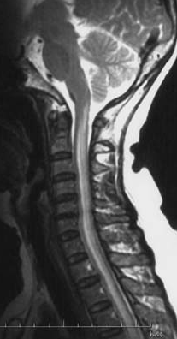
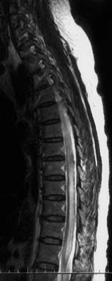
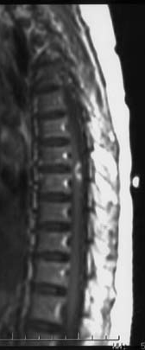
Syphilitic myelitis
Eur Radiol (2002) 12:2973–2976

Slide 12
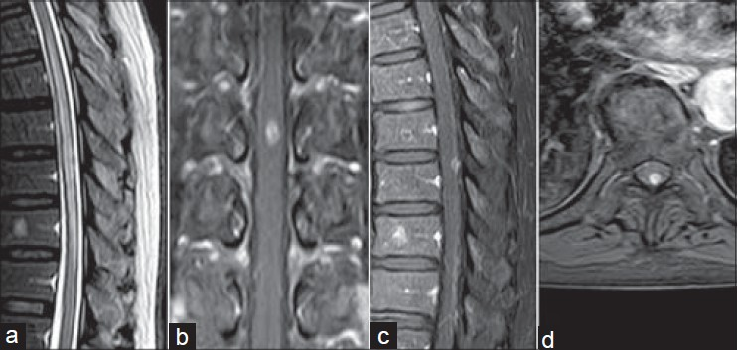
Syphilitic myelitis
Neurol India. 2014 Jan-Feb;62(1):89-91

Slide 13
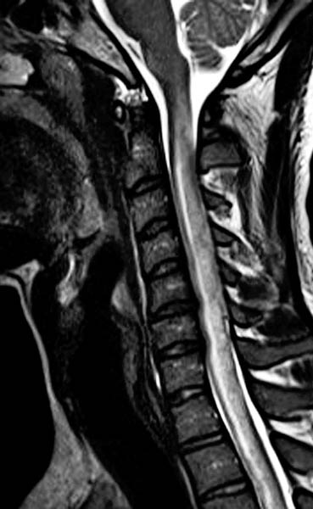
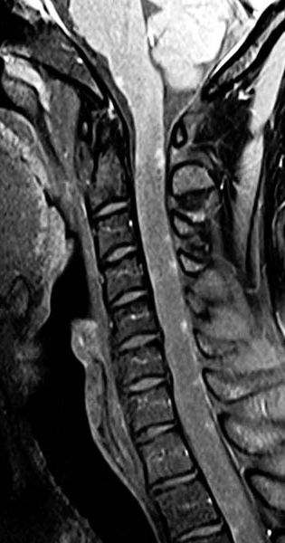
Syphilitic myelitis http://radiologykey.com/syphilitic-myelitis/

Slide 14
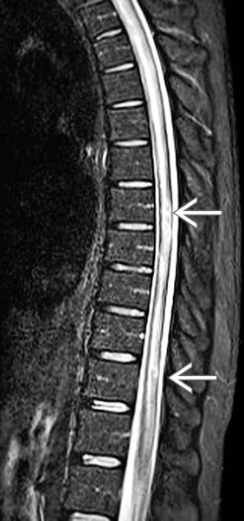
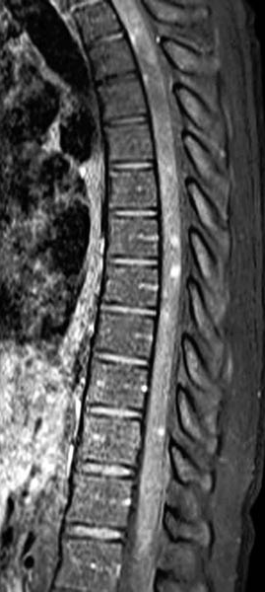
Syphilitic myelitis http://radiologykey.com/syphilitic-myelitis/

