Slide 1
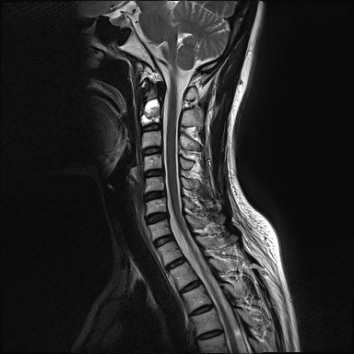
47/F
Neck pain
P.Hx.
  Sublingual mucoepidermoid carcinopma op and RTx, 7 years before
  Lung metastasis , VATS biopsy, CTx.
Courtesy of
JeeEun Cho
milkbear92@naver.com

Slide 2
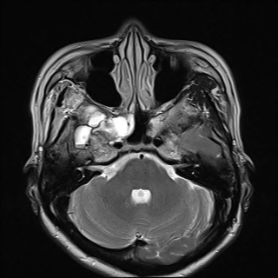
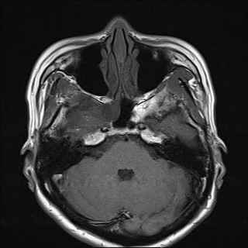
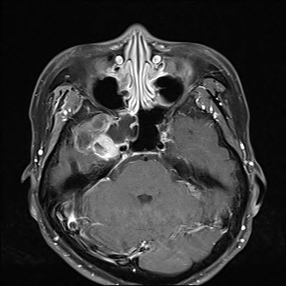
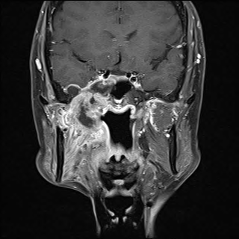
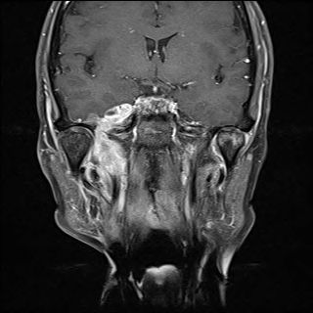

Slide 3
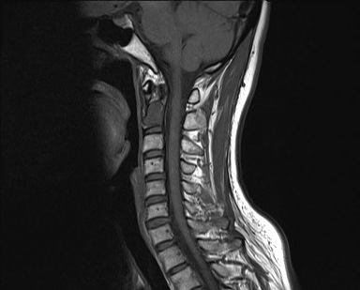
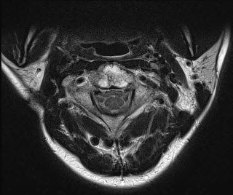
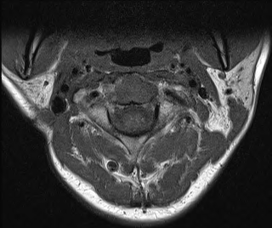

Slide 4
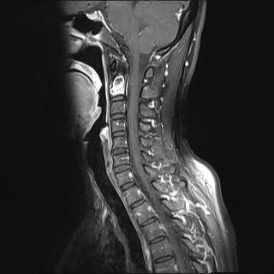
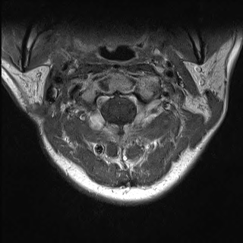

Slide 5
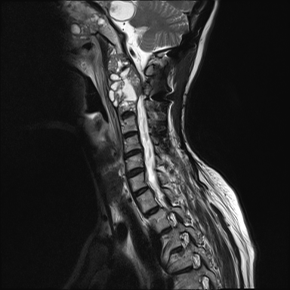
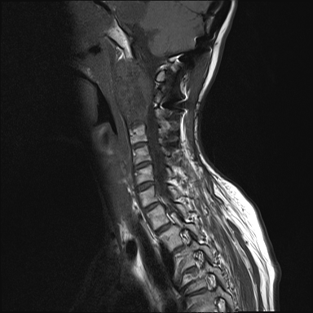
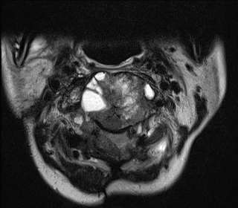
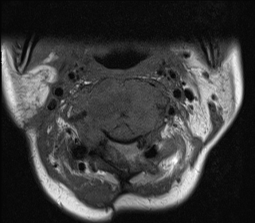

Slide 6
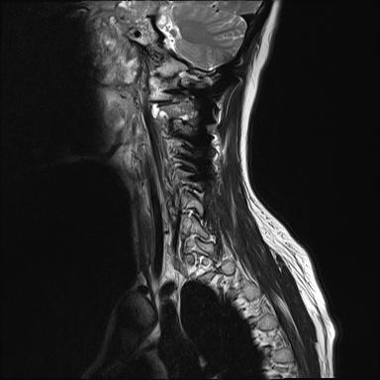
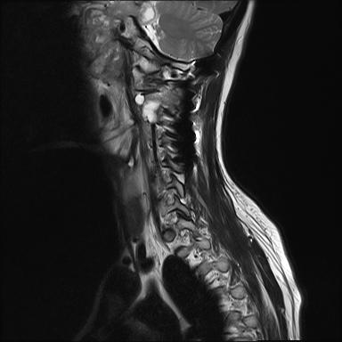
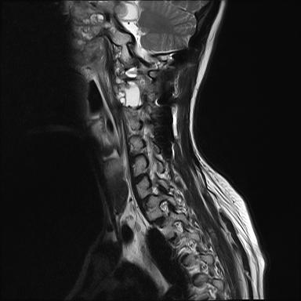

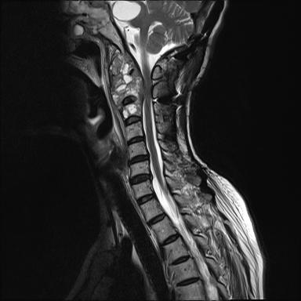
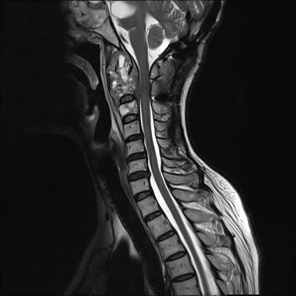
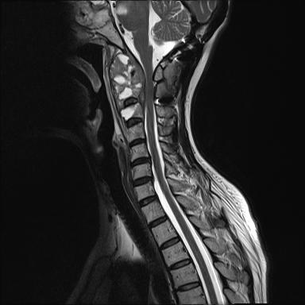
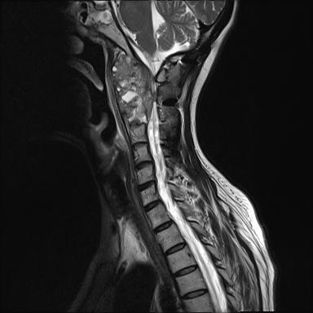
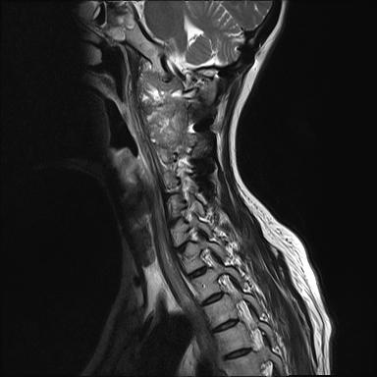
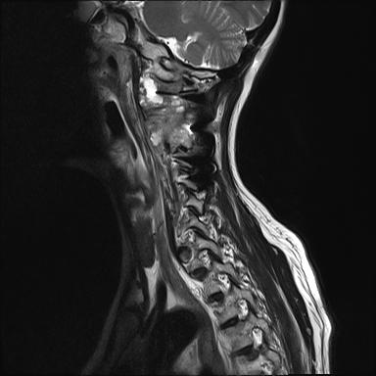
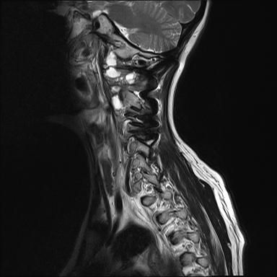
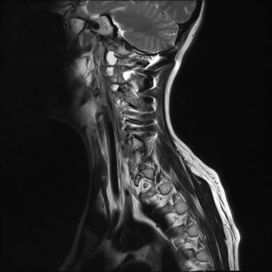
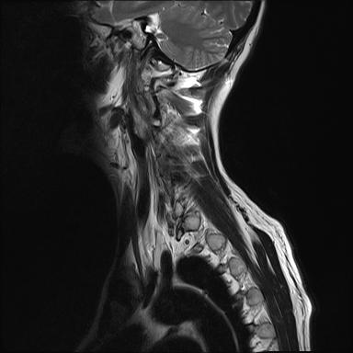

Slide 7
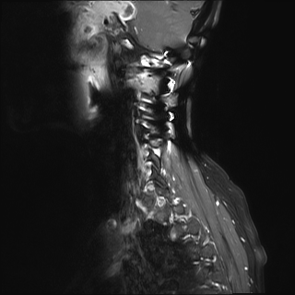
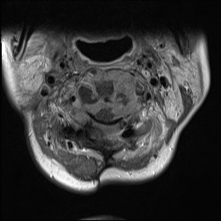

Slide 8
Mucoepidermoid carcinoma
Tumor that usually occurs in the salivary glands.
Location
  Major salivary glands: ~50%
    parotid gland: ~40%
    submandibular gland: ~7%
    sublingual gland: ~3%
  Minor salivary glands: ~50%
    palate: most common
    retromolar trigone, floor of the mouth, buccal mucosa,
    Lip, tongue
    other:
      anywhere in the proximal aerodigestive tract, the lacrimal glands and even in the bronchi

Slide 9
Histology
  Histology will often show clear mucin containing cells
  low grade:
    well-differentiated cells with little cellular atypia
    high proportion of mucous cells
    prominent cyst formation
  intermediate grade
  high grade
    poorly differentiated with cellular pleomorphism
    high proportion of squamous cells
    solid with few if any cysts

Slide 10
MRI
  Imaging is dependent on grade.
  Low-grade
    T1: low signal cystic spaces
    T2: cystic areas will be high signal
    T1 C+ (Gd): heterogeneous enhancement of solid components
  High grade
    lower signal on T2 and poorly defined margins and infrequent cystic areas
    T1: low to intermediate signal
    T2: intermediate to low signal

Slide 11
Prognosis
  Very dependent on grade
  Lymph node metastasis
    Related to histologic malignancy
  Distant metastasis
    Related to the size and histologic malignancy
    distant tumor spread is rare
    usually occurs many years after diagnosis
    Common site : lung, liver and brain

