Slide 1
20 year old female
Painful right hip
Improving with non-steroidal antirheumatics
No trauma
MR Arthography shows focal hypointens signal in the cartilage and subchondral bone plate of the femoral head with surrounding bone marrow edema like signal
What is this? Should I recommend a CT?

Slide 2
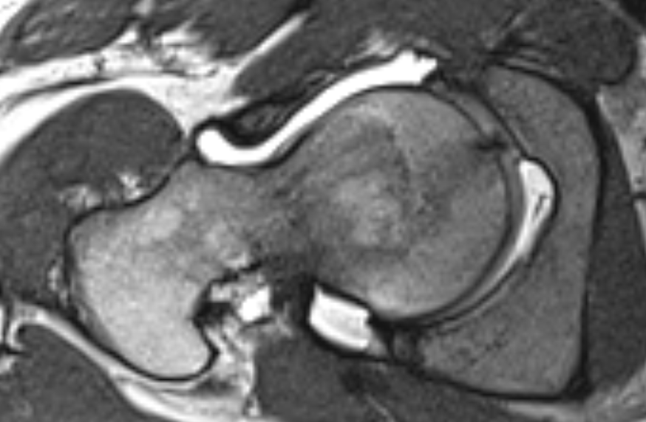
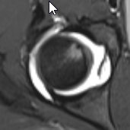
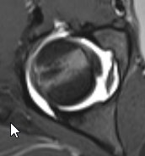
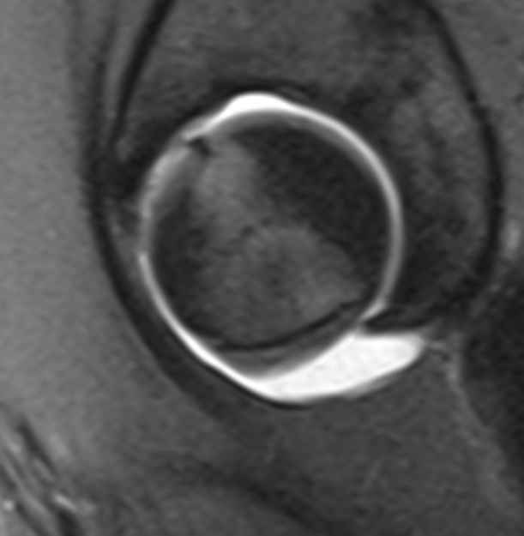
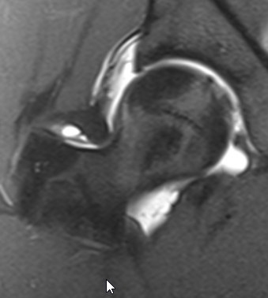
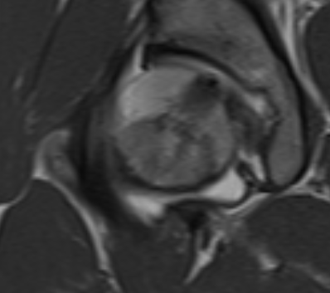
3D-Space PD
PD fs
T1

